Slide 1

AWS Infrastructure Automation Using TERRAFORM
~ SPANDANA BAINDLA

Slide 2

WHAT IS TERRAFORM ?
Terraform is an Infrastructure as Code (IaC) tool. Works with multiple platforms like AWS, Azure, and Google Cloud. Ensures consistent, repeatable, and automated deployments. You write infrastructure details in configuration files and apply them to provision resources.

Slide 3
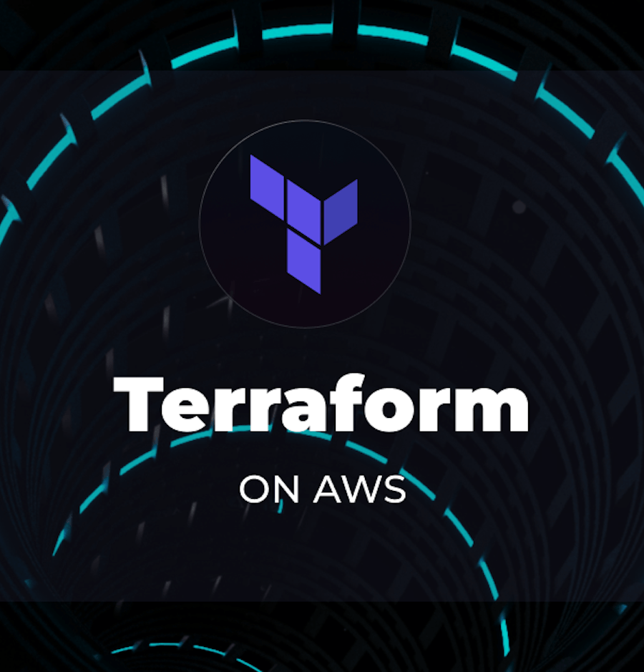
ADENDA
1. Infrastructure Setup with Terraform
2. Network Architecture
3. Instance and Security
4. Scalability and Load Balancing
5. Database management
6. Output and Finalization

Slide 4
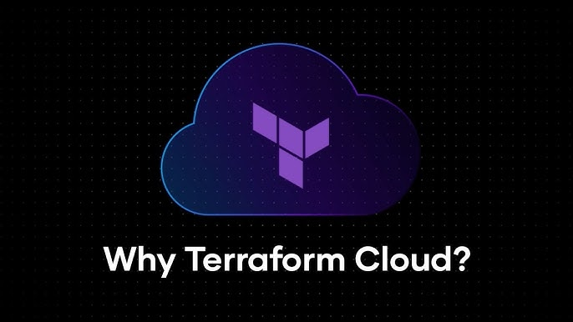
WHY TERRAFORM?
Saves Time
Version Control
Platform Agnostic
Automation
Scalability
Cost Efficiency
Faster Deployments
Improved Reliability

Slide 5
TERRAFORM COMMANDS
terraform init
terraform validation
terraform plan
terraform apply
terraform show
terraform destroy

Slide 6
PROCESS WE FOLLOWED
Install Terraform
Configure AWS CLI
Create Terraform Configuration Files
Initialize Terraform
Preview Infrastructure Changes
Deploy the Infrastructure
Verify in AWS Console

Slide 7
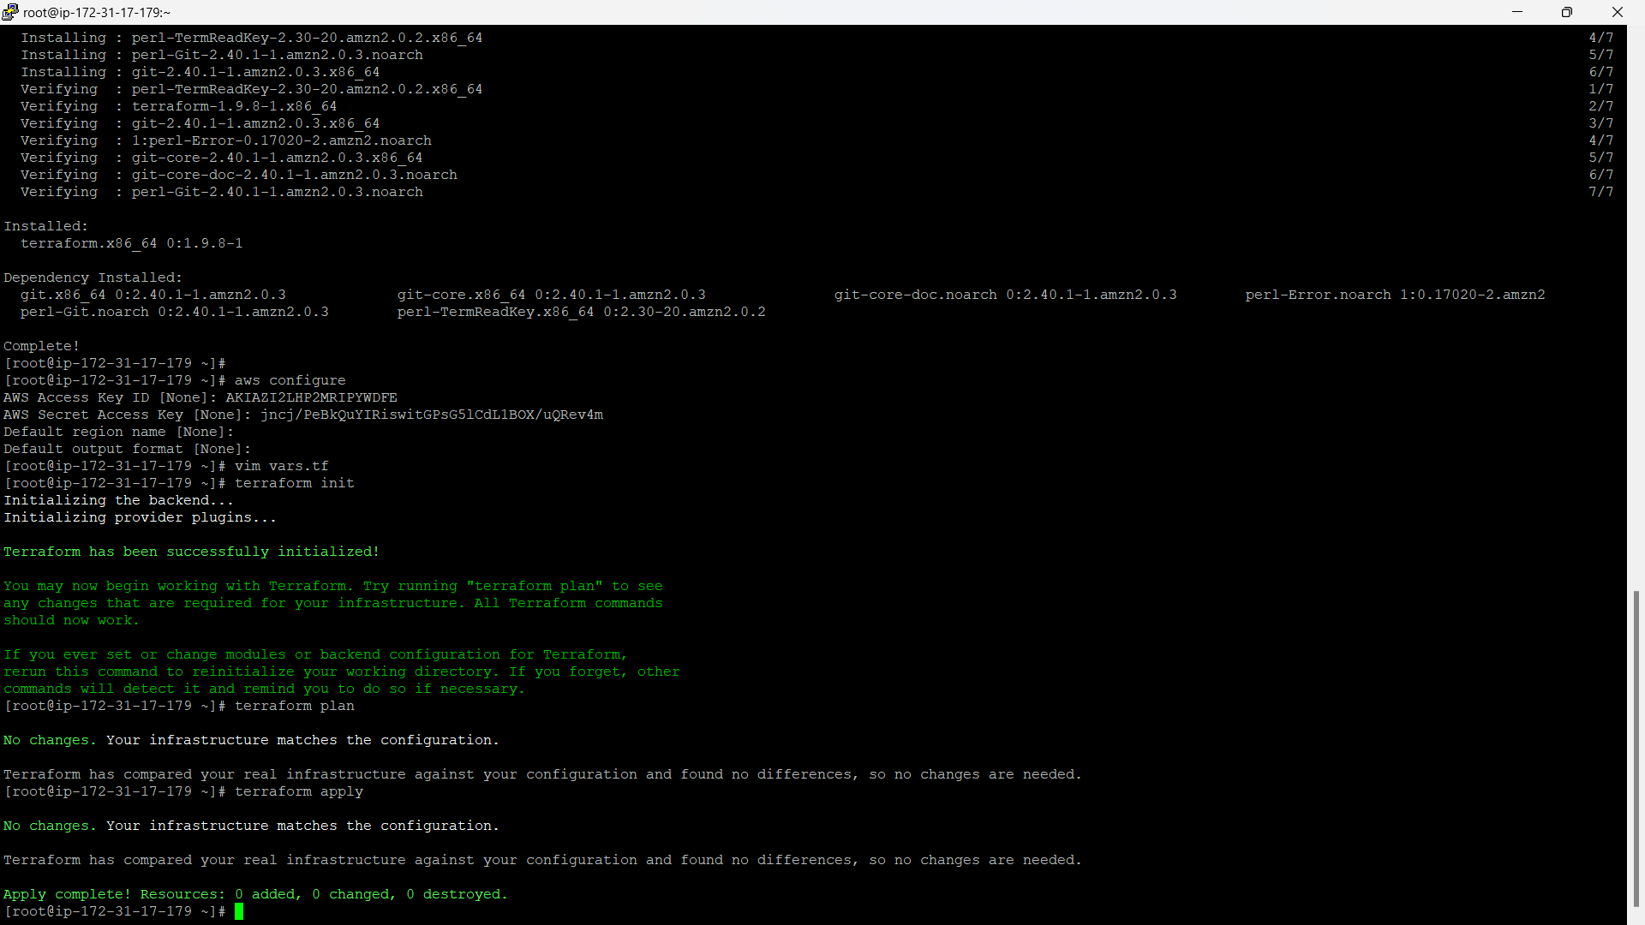
STEP-1 CREATE VARIABLES
Variables in Terraform allow you to store values that can be reused in different parts of your configuration. They help make your code more flexible and easier to manage. You can also set default values or prompt for them during the apply process. This makes your Terraform files cleaner and easier to update when needed.

Slide 8
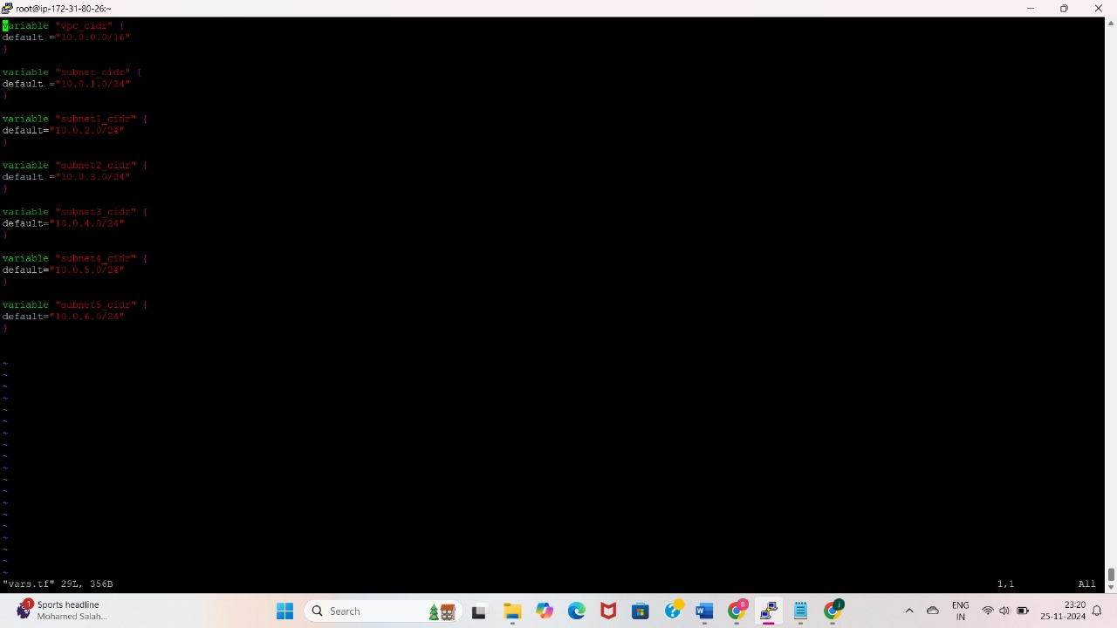
vars.tf file for creating variables

Slide 9
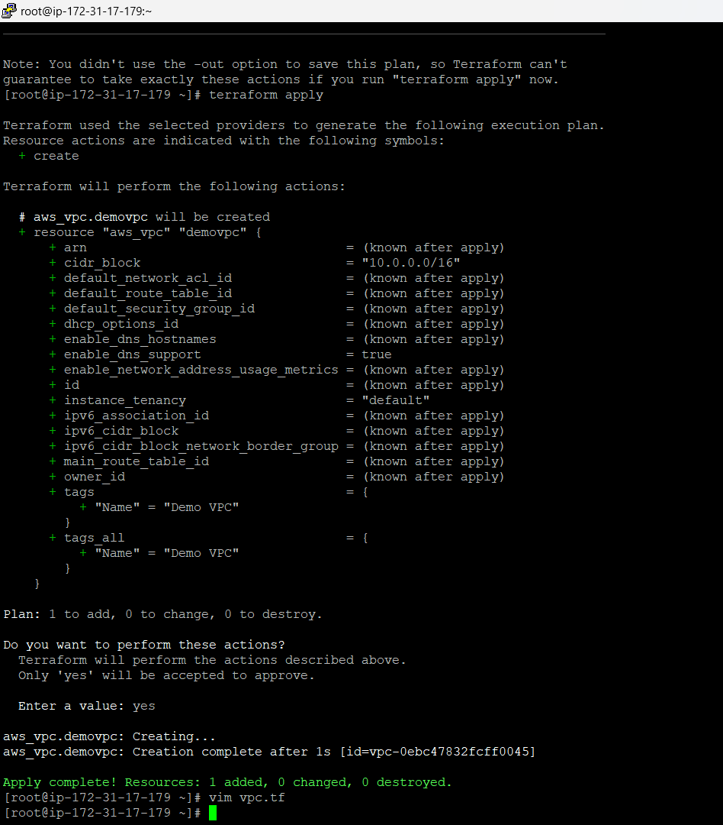
STEP-2 CREATE VPC
A VPC (Virtual Private Cloud) is a private network within the cloud that you can configure to host your resources. It allows you to control the IP address range, subnets, route tables, and network gateways. Think of it as your own isolated section of the cloud where you can securely run your applications. By using a VPC, you can control traffic flow between resources, ensuring that sensitive data remains protected. It's like creating a secure, private space on the cloud for your infrastructure.

Slide 10
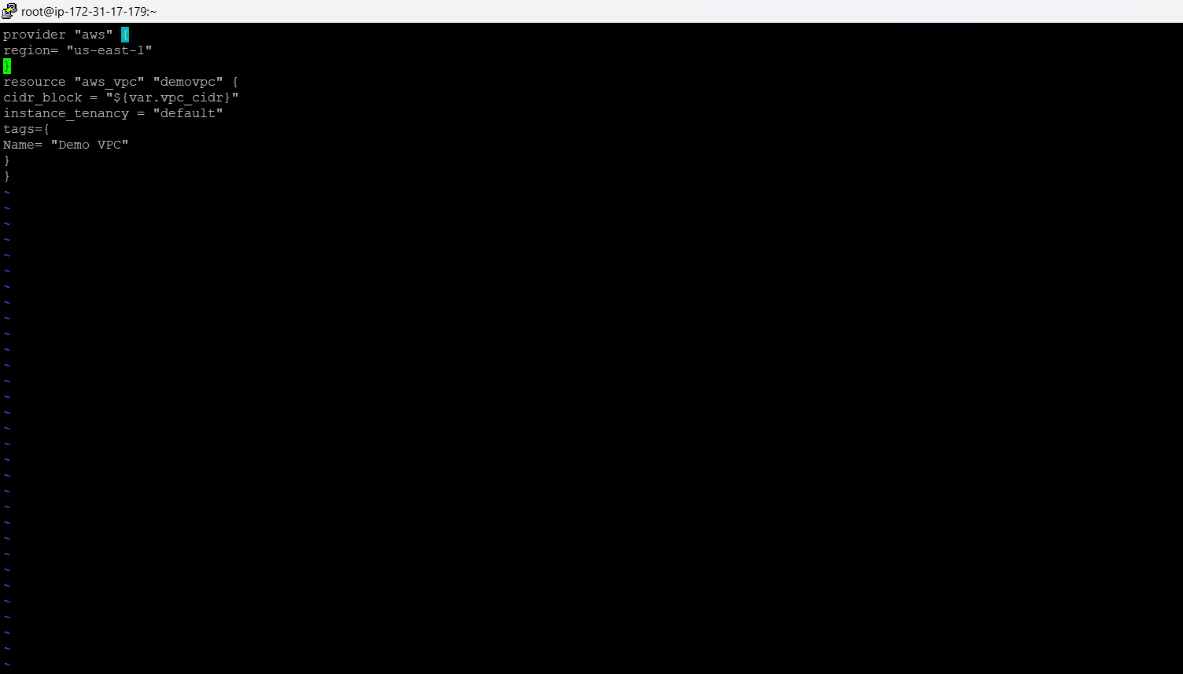
Vpc.tf file for creating an VPC

Slide 11
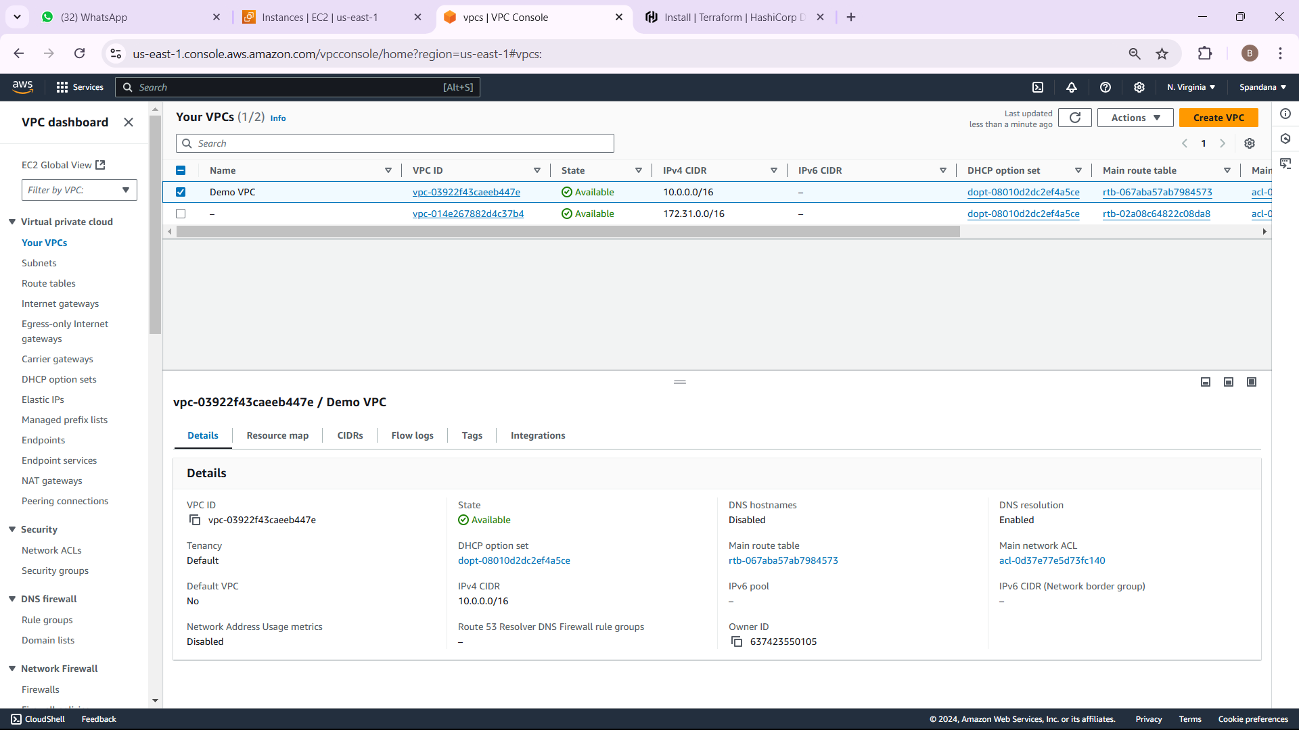
OUTPUT FOR VPC

Slide 12
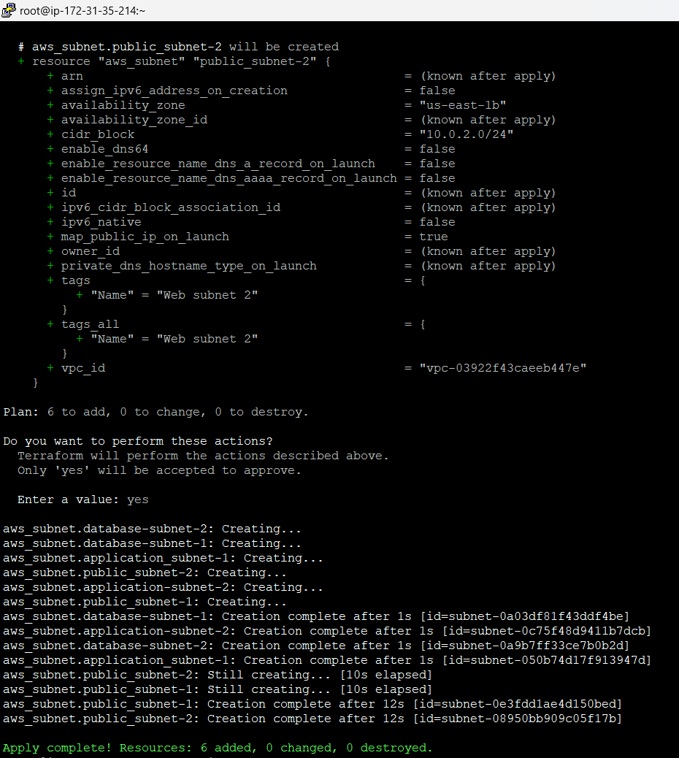
STEP-3 CREATE SUBNETS
Subnets divide a network into smaller, manageable sections. In AWS, you create subnets within a VPC to organize resources like EC2 instances. You can have public subnets (accessed from the internet) and private subnets (isolated from the internet). Subnets help improve security and manage traffic efficiently between different parts of your infrastructure.

Slide 13
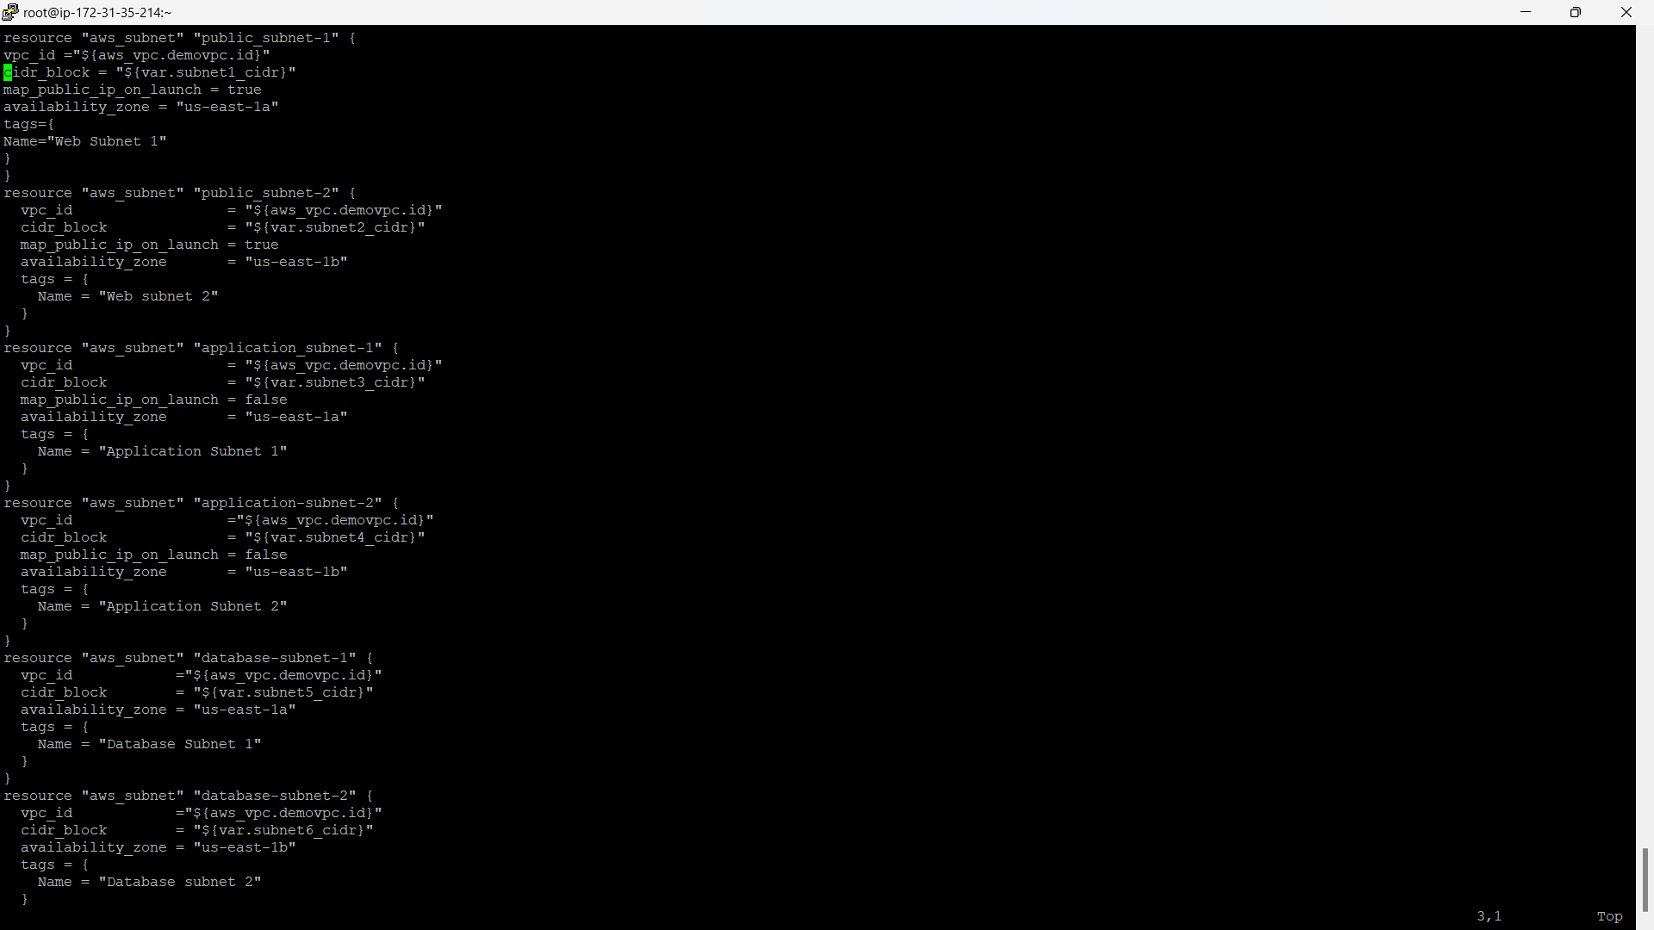
Subnet.tf file for creating subnets

Slide 14
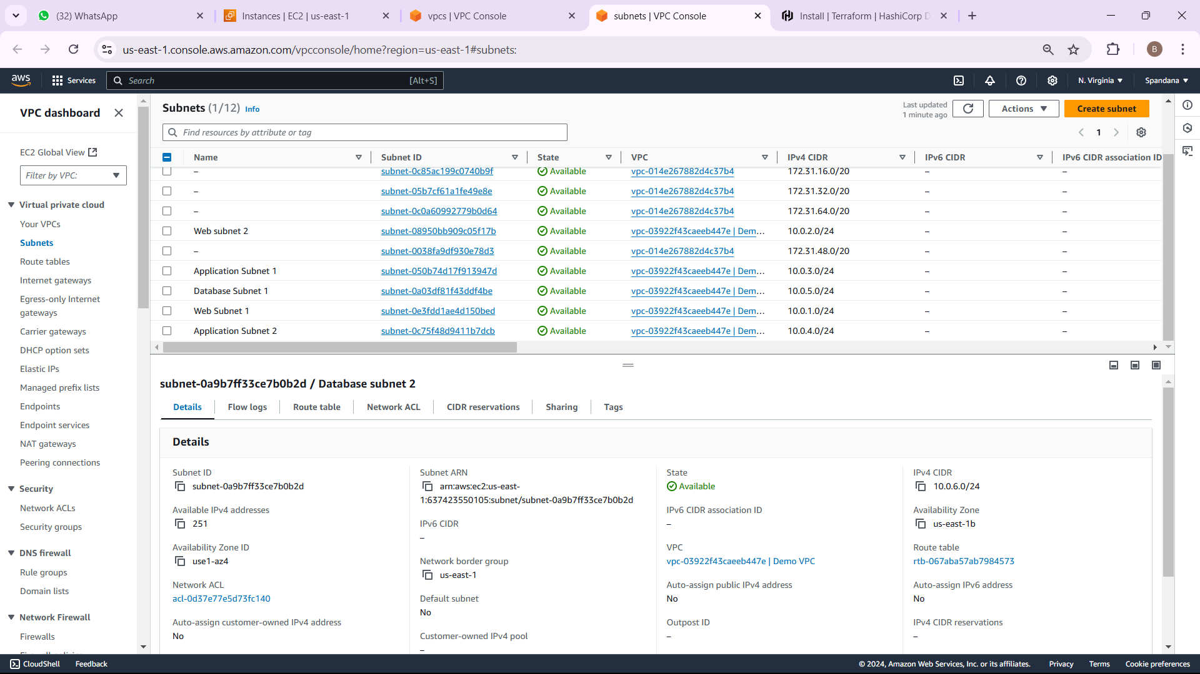
OUTPUT FOR SUBNETS

Slide 15
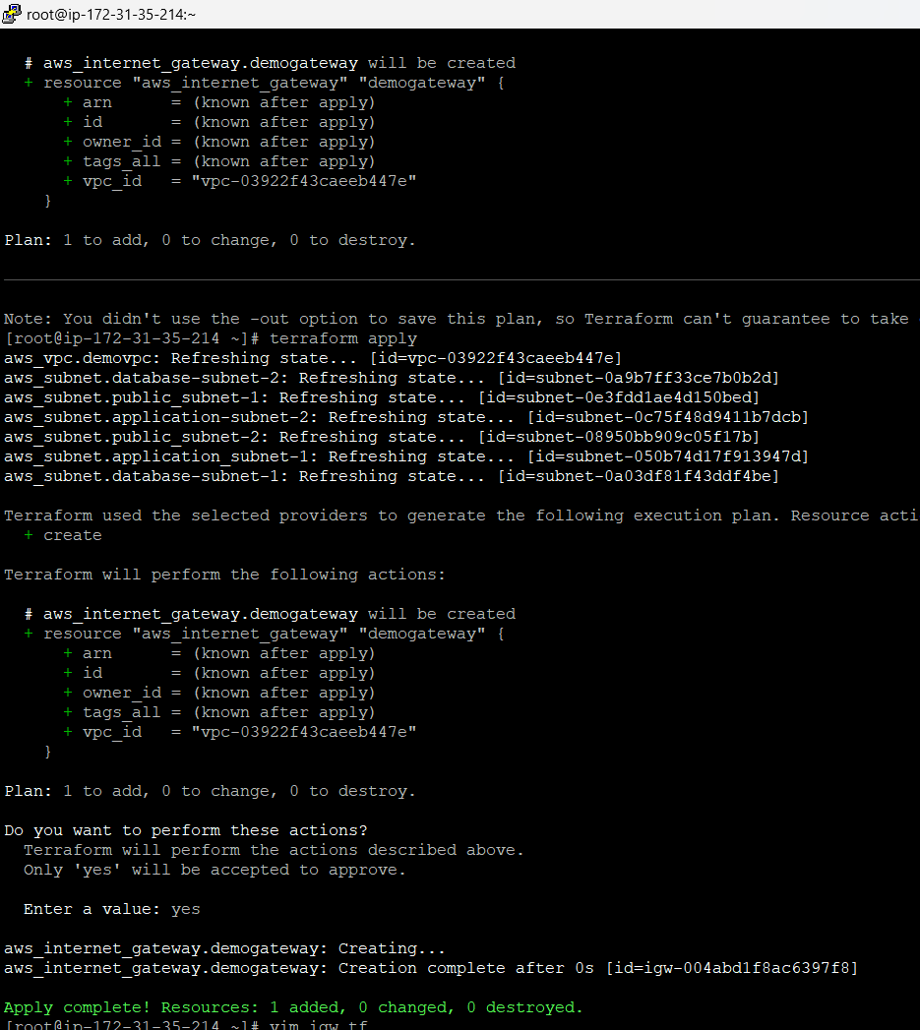
STEP- 4 CREATE IGW
An Internet Gateway (IGW) is a component in AWS that allows communication between your VPC (Virtual Private Cloud) and the internet. It enables instances within a VPC to access the internet and receive incoming traffic. When you create an IGW, it connects your VPC to the internet, allowing resources like EC2 instances to be publicly reachable. The IGW is essential for making your VPC resources accessible outside of the cloud environment.

Slide 16
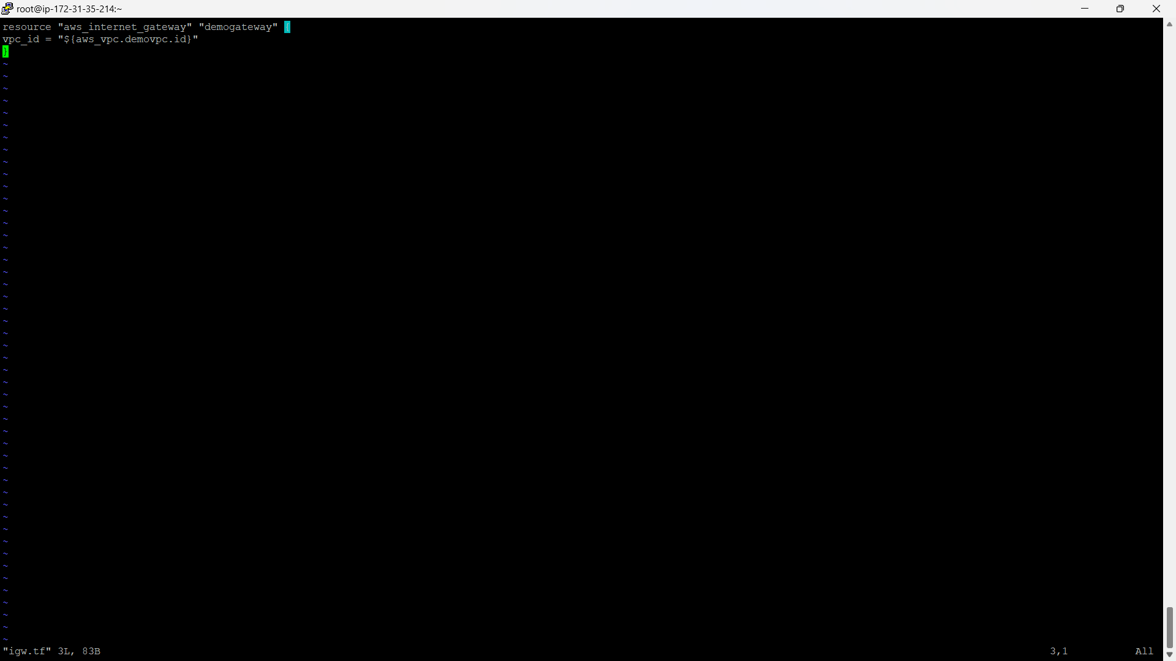
igw.tf file for creating internet gateway

Slide 17
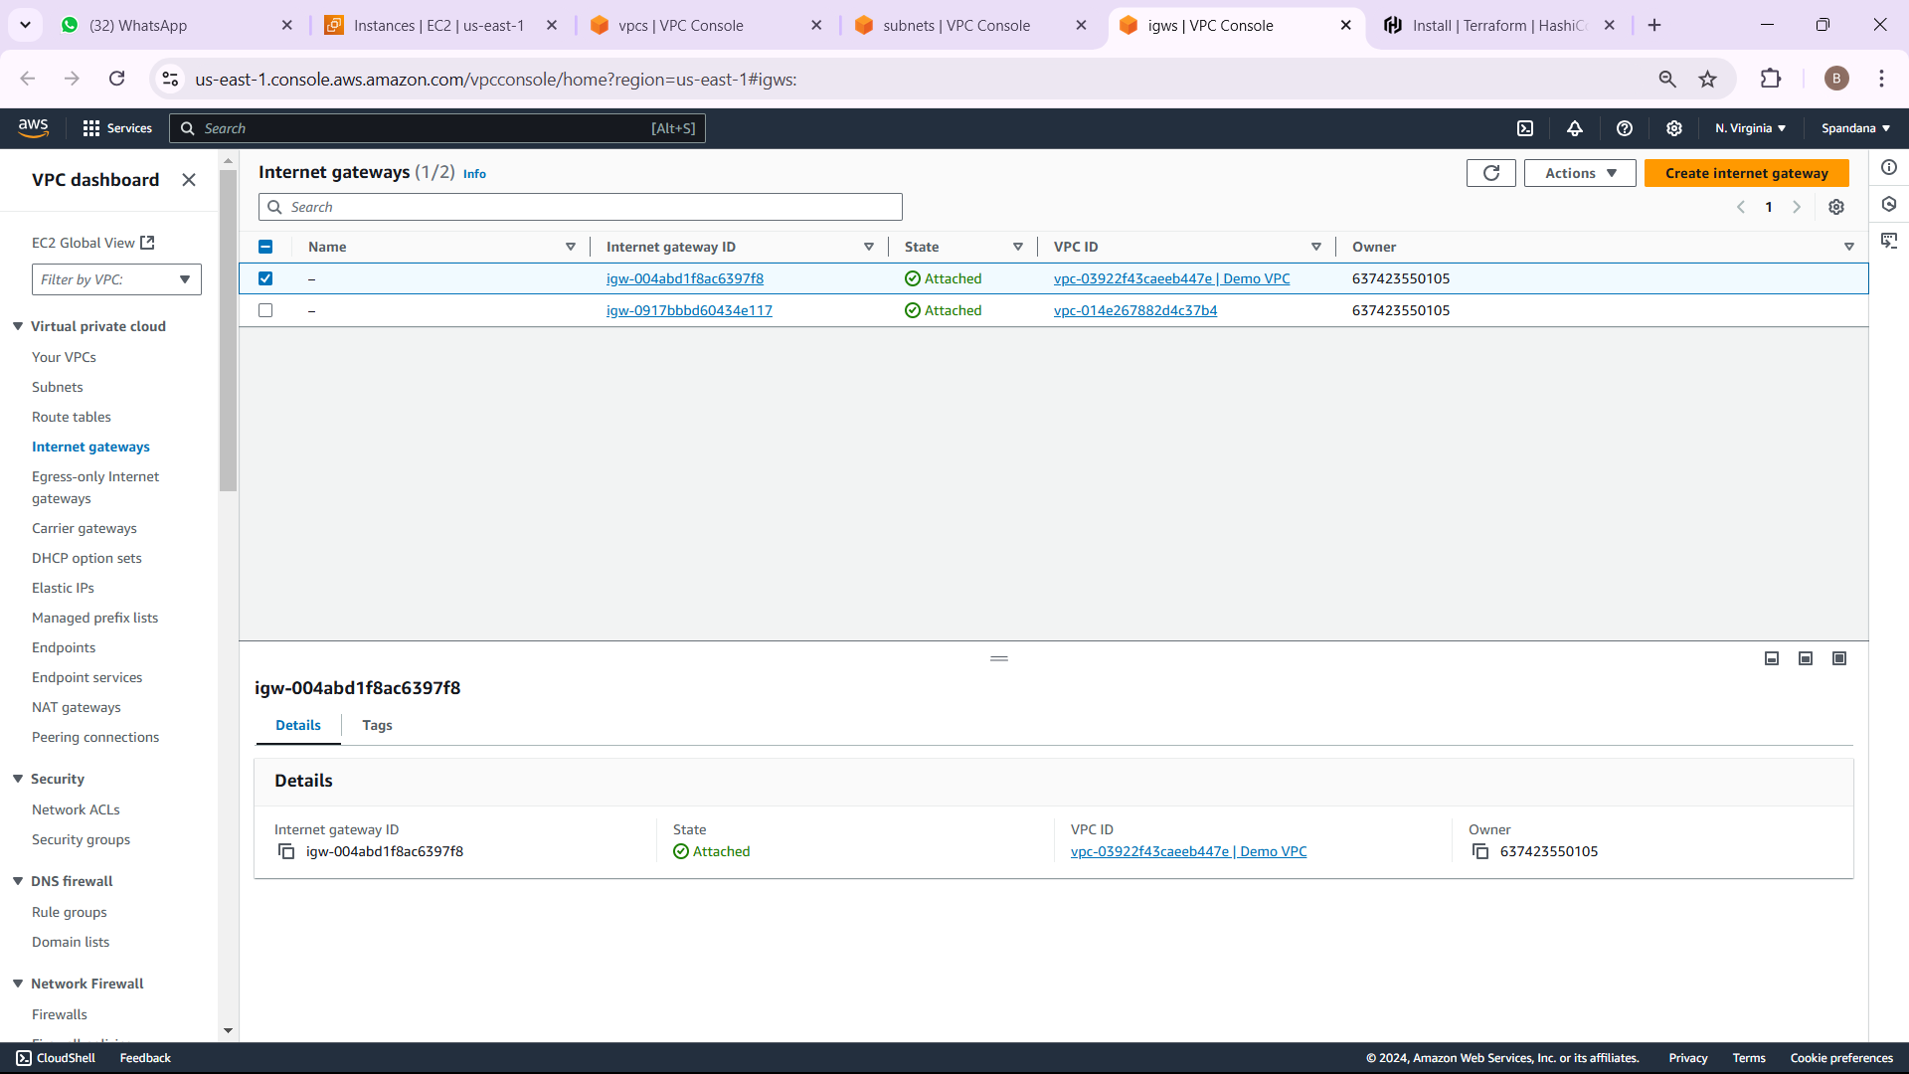
OUTPUT FOR IGW

Slide 18
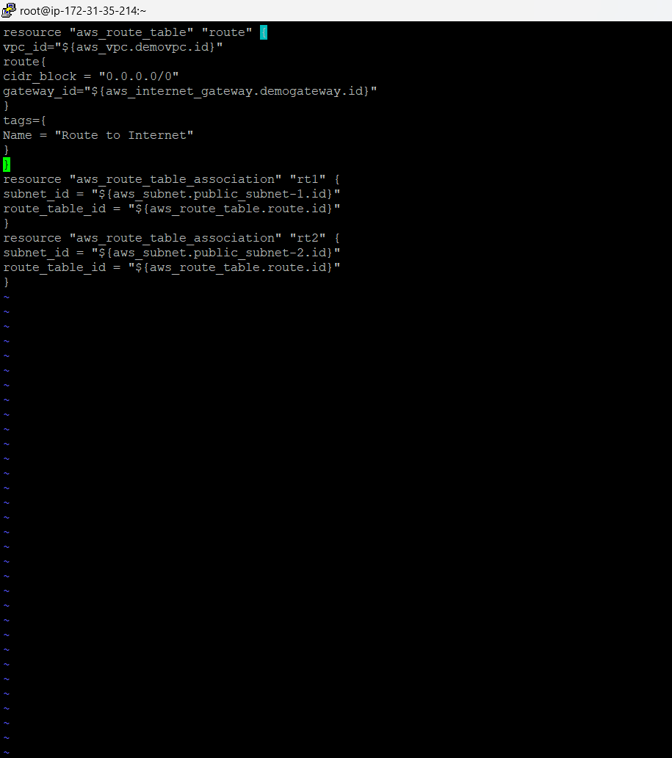
STEP- 5 CREATE ROUTE TABLE
A Route Table in AWS is a collection of rules (called routes) that decide how network traffic from your VPC is directed. Each subnet in the VPC is linked to a specific route table, which defines how traffic should be routed to destinations like the internet, other subnets, or external networks. These rules ensure that data moves efficiently between resources within the VPC and beyond.

Slide 19
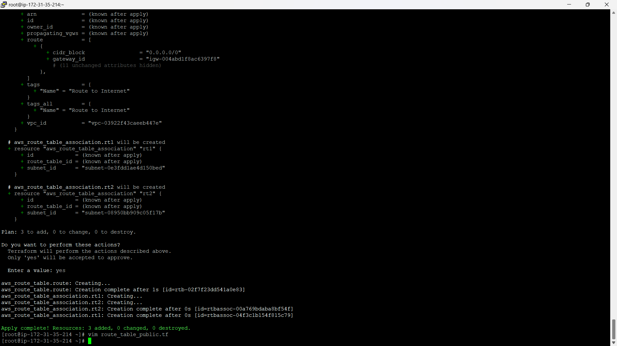
Creation of route_table_public.tf file

Slide 20
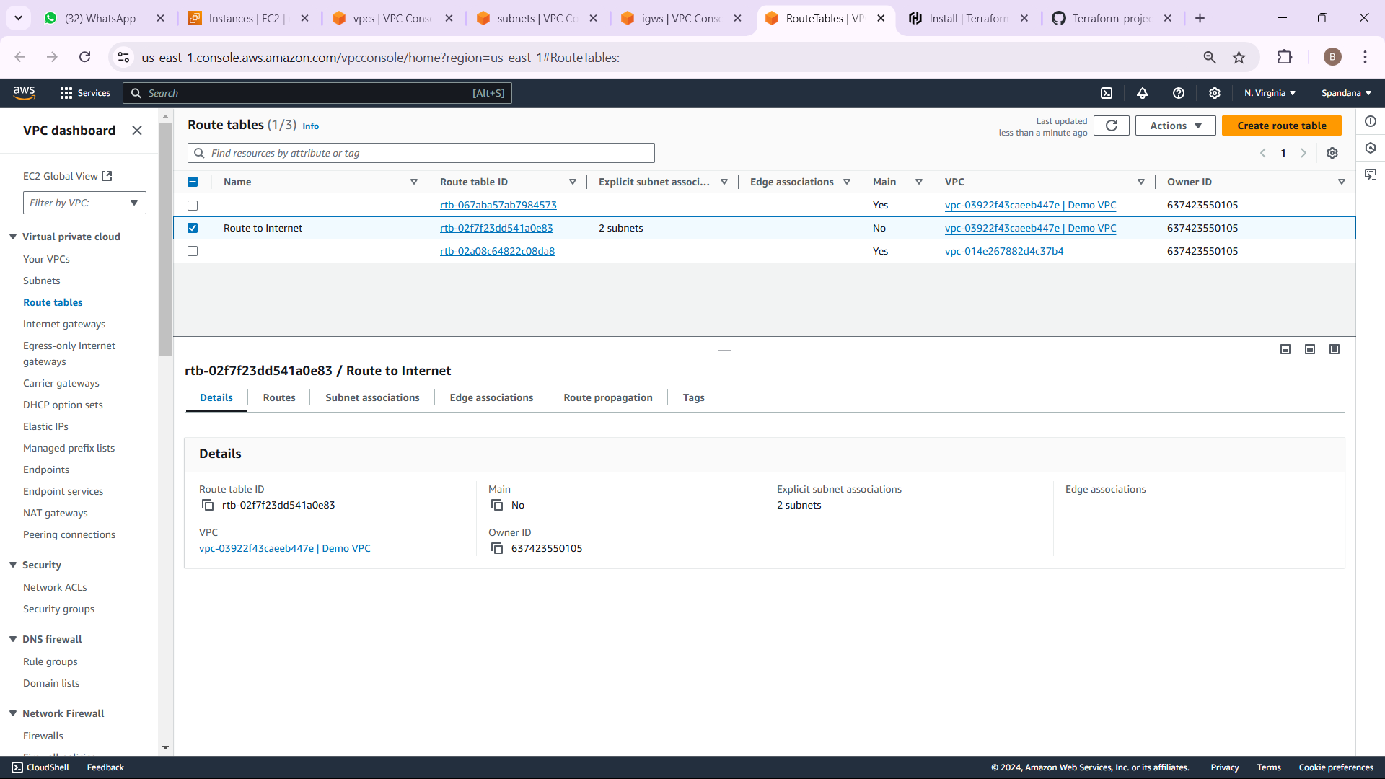
OUTPUT FOR ROUTE TABLE

Slide 21
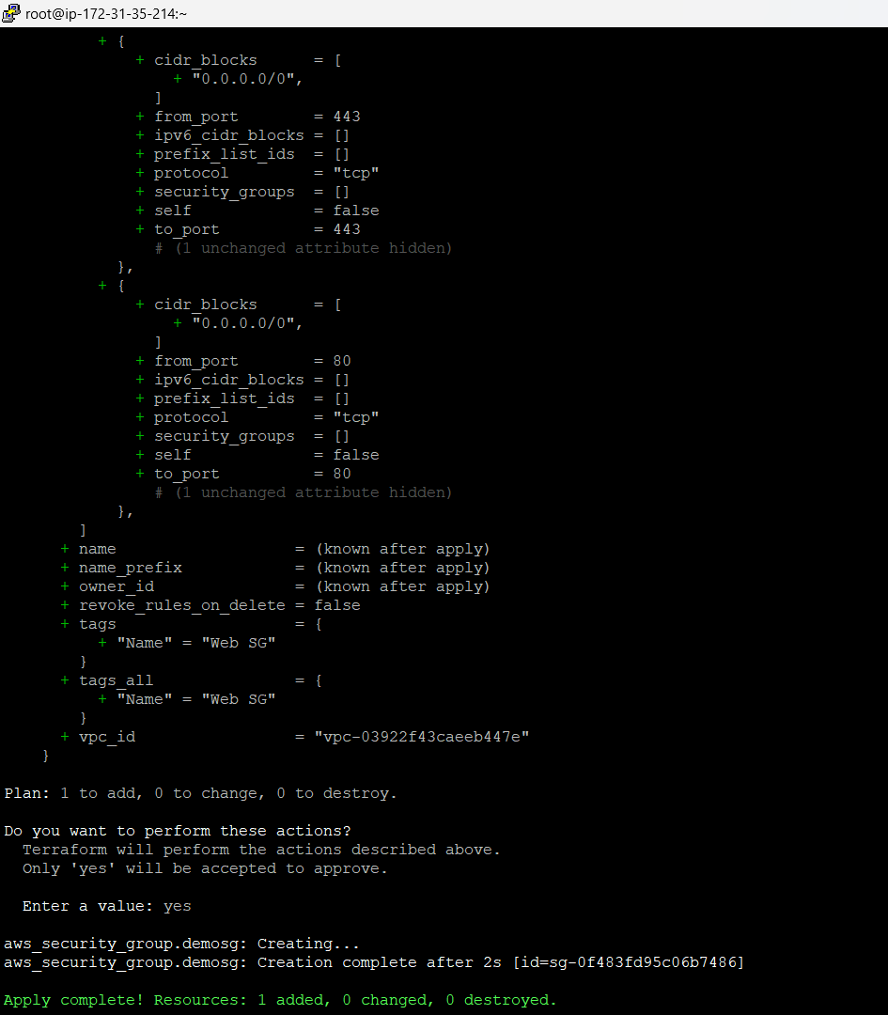
STEP- 7 CREATE SECURITY GROUP
A Frontend Security Group in AWS is a set of firewall rules that manage the traffic to and from resources like EC2 instances in your application's frontend layer. It allows:
HTTP (port 80) and HTTPS (port 443) traffic from the internet for web application access.
SSH (port 22) traffic only from trusted IP addresses for secure administration.
These rules help ensure your frontend resources are accessible while maintaining security.

Slide 22
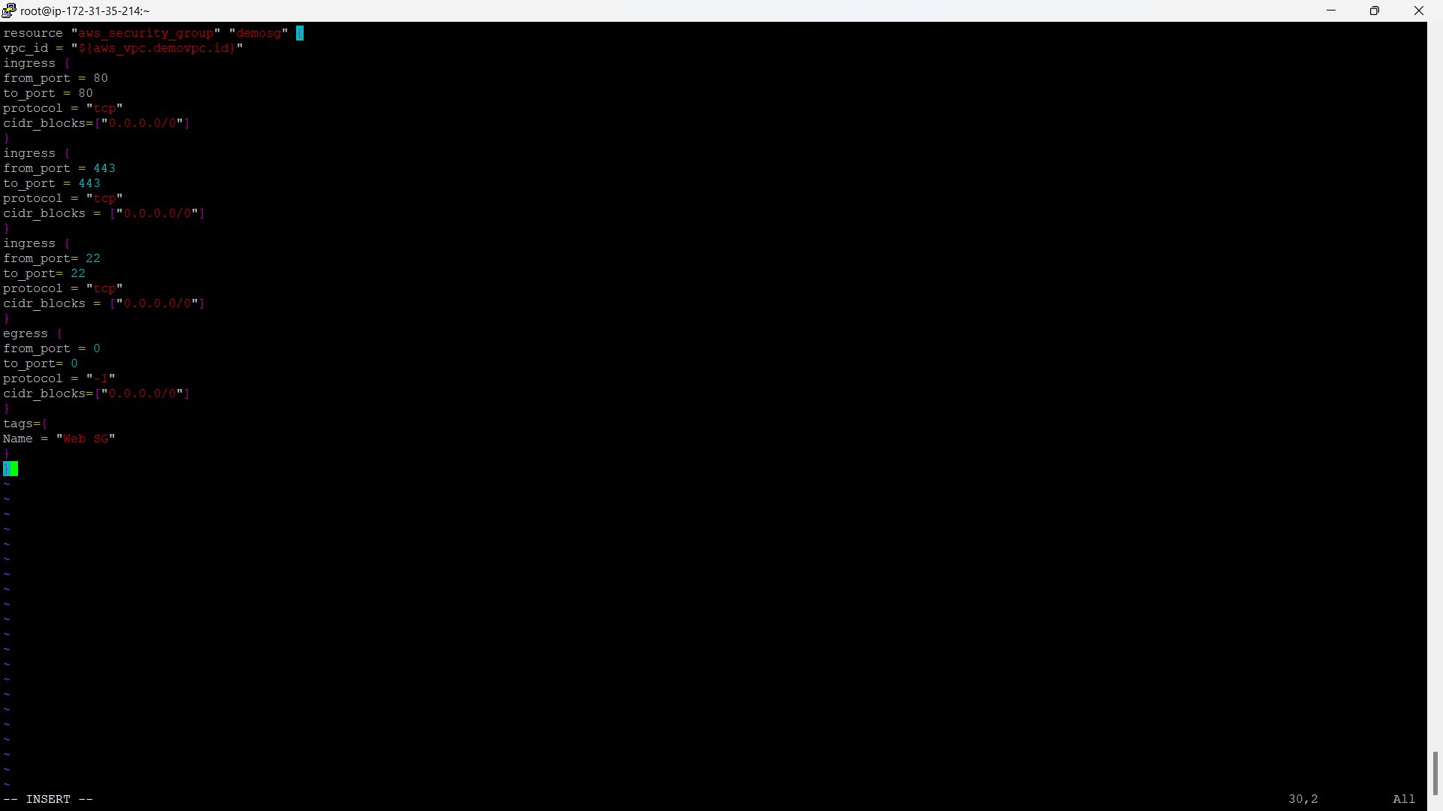
Web_sg.tf file for security group

Slide 23
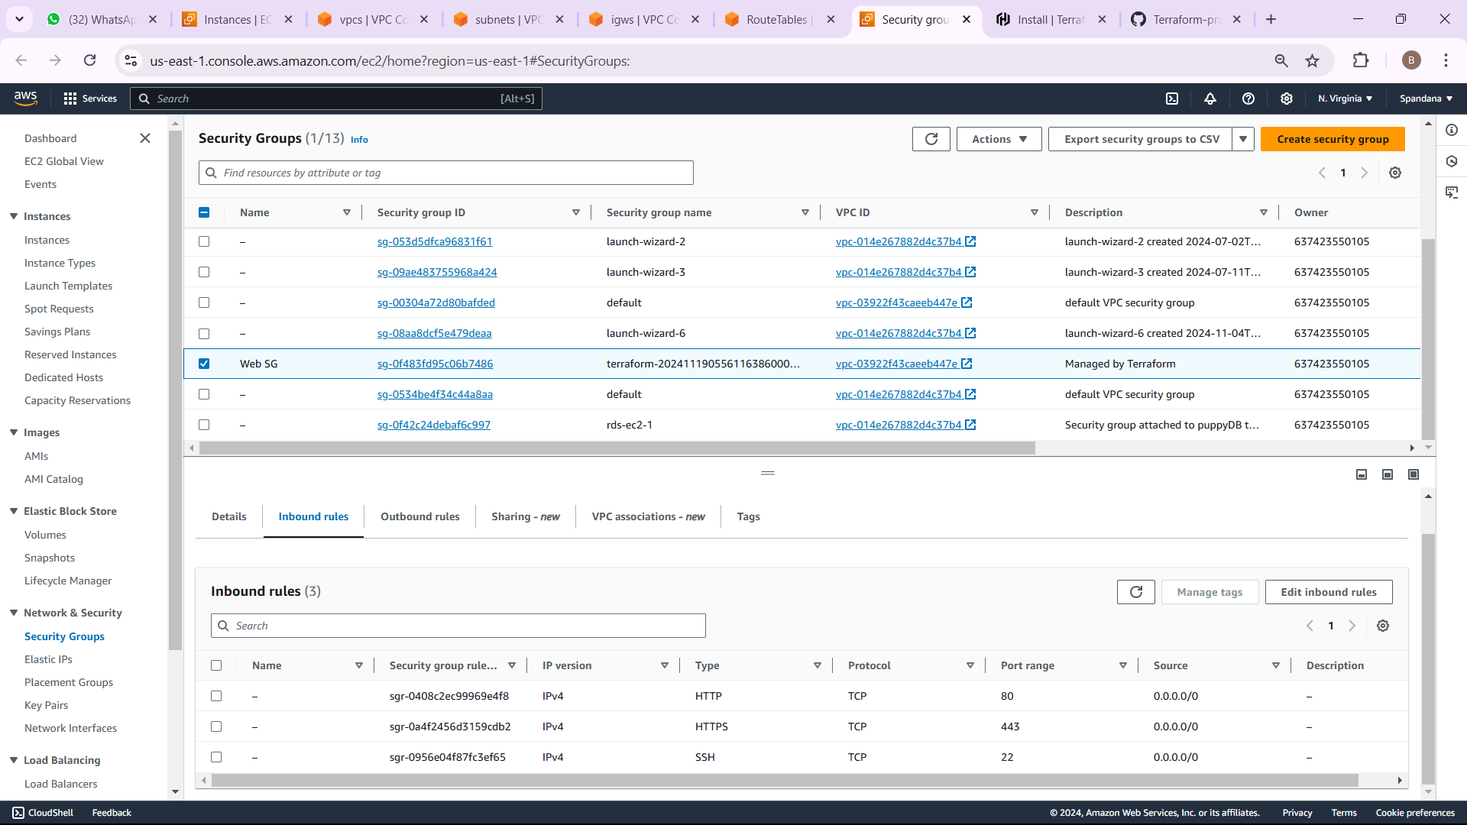
OUTPUT FOR WEB SECURITY GROUP

Slide 24
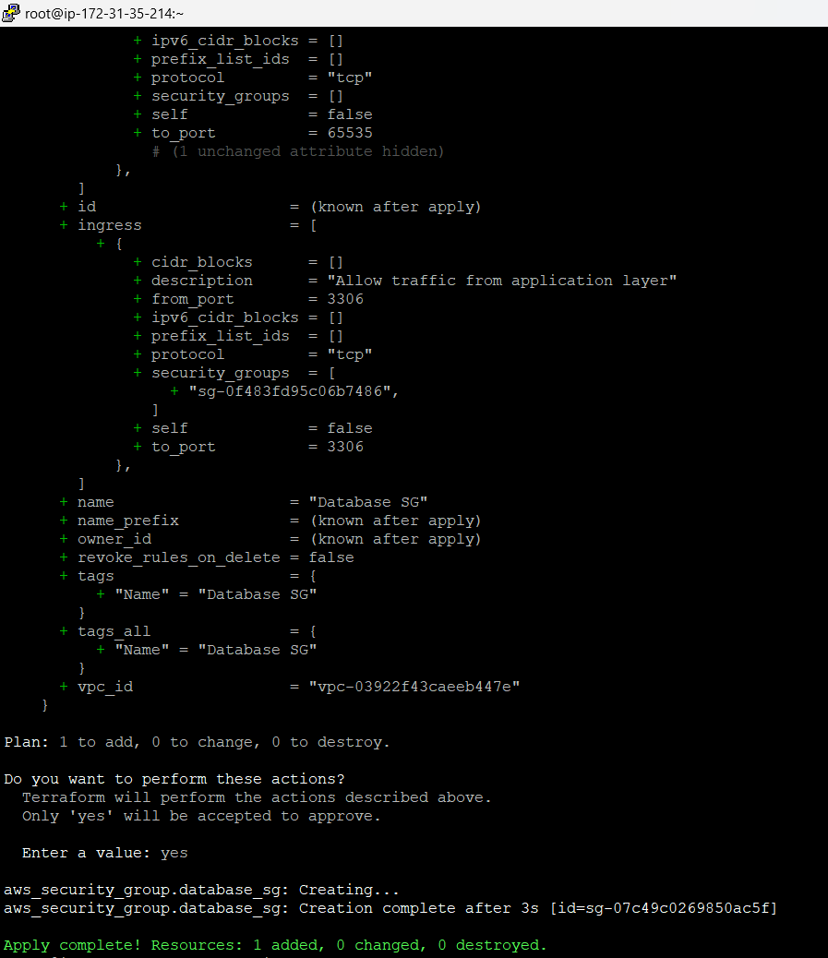
STEP- 9 CREATE SECURITY GROUP FOR DATABASE
A Database Security Group is a set of firewall rules in AWS that controls inbound and outbound traffic to database resources (e.g., RDS instances). Typically, it allows: Traffic from trusted sources(e.g., EC2 instances in the same VPC or specific IP ranges) on database ports (e.g.,MySQL: 3306,PostgreSQL: 5432). Deny all other traffic to secure the database from unauthorized access.

Slide 25
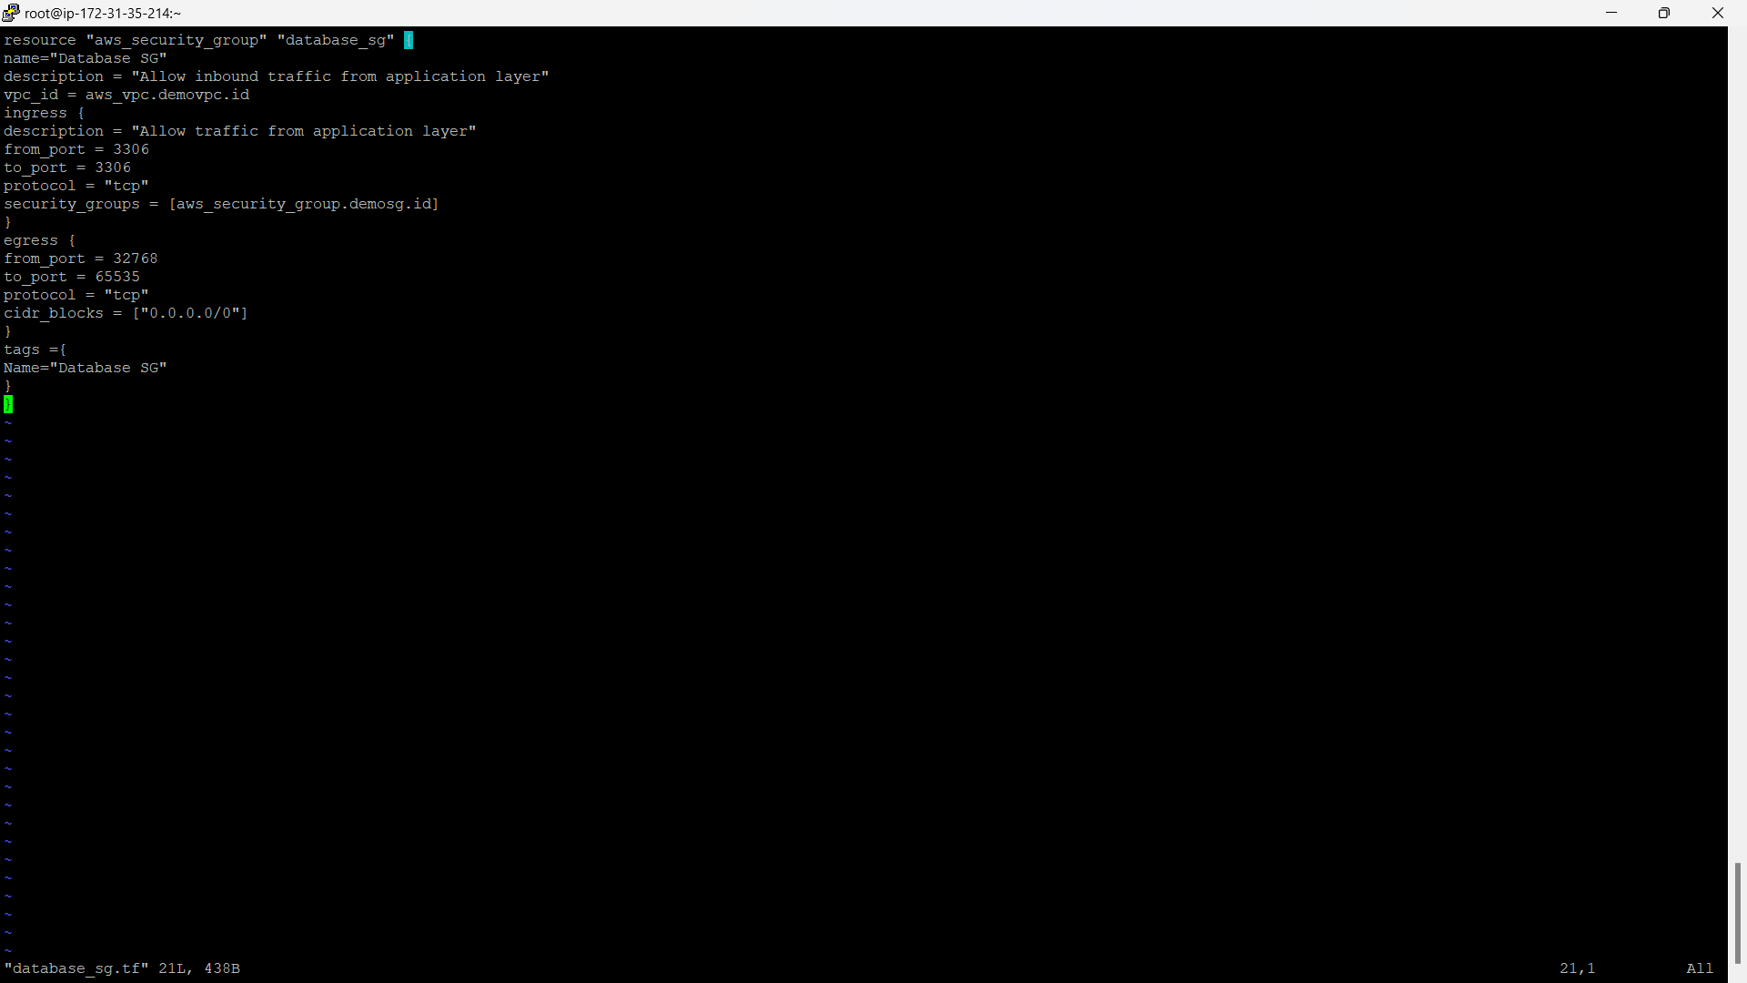
Database_sg.tf file for database security group

Slide 26
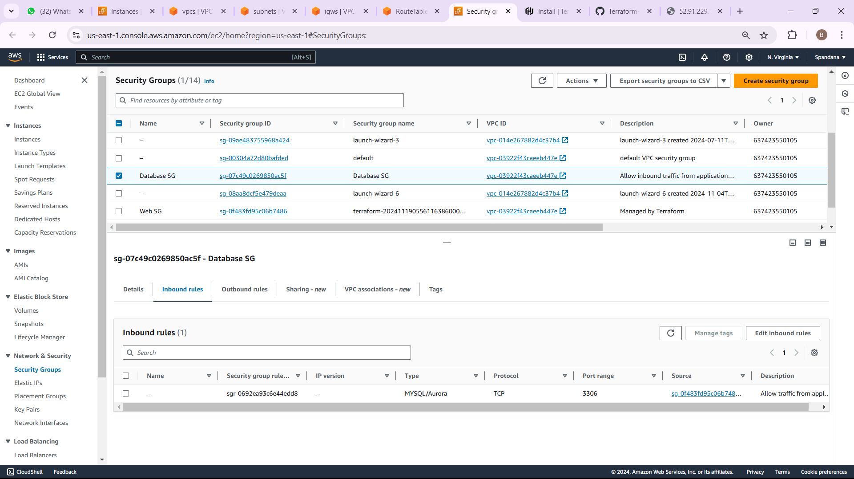
DATABASE SECURITY GROUP INBOUND RULES OUTPUT

Slide 27
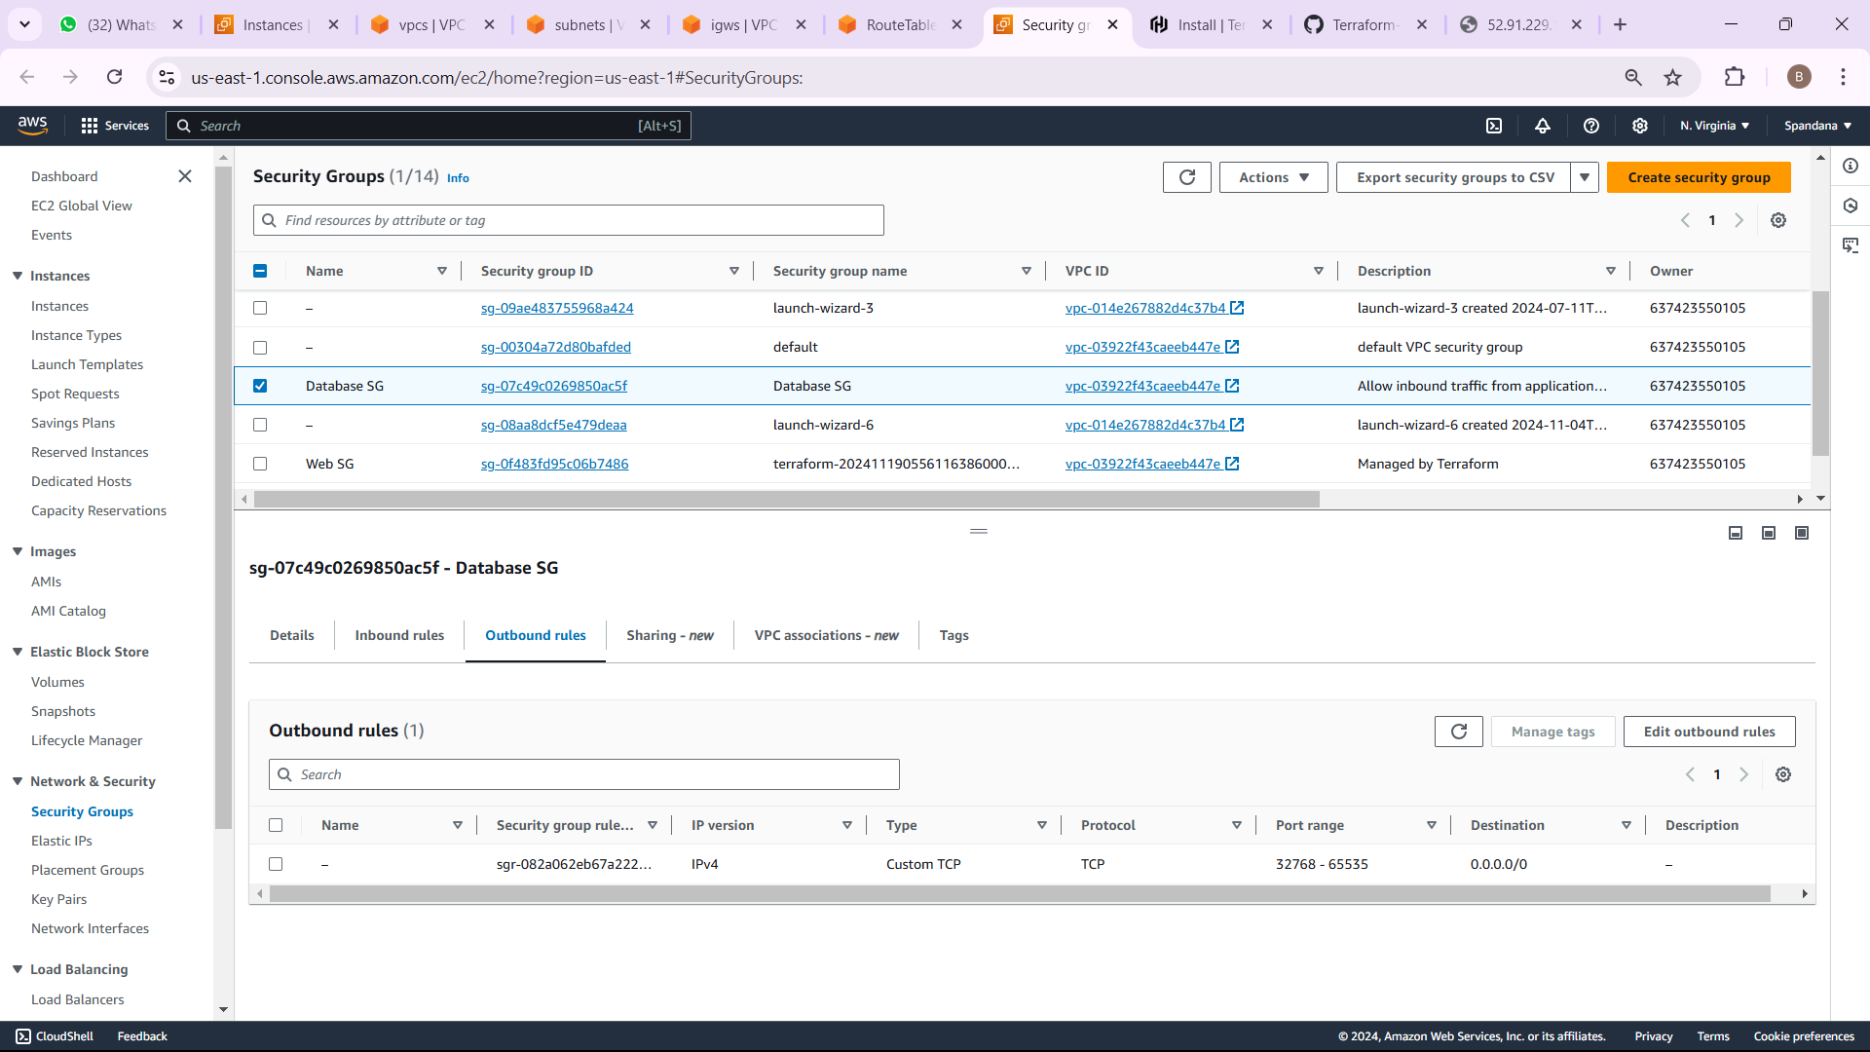
DATABASE SECURITY GROUP OUTBOUND OUTPUT

Slide 28
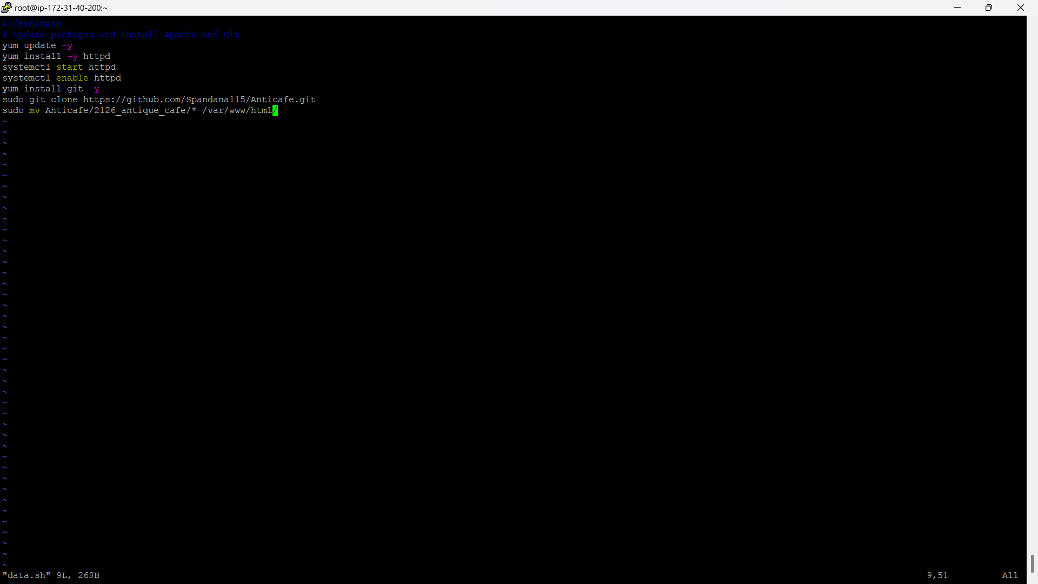
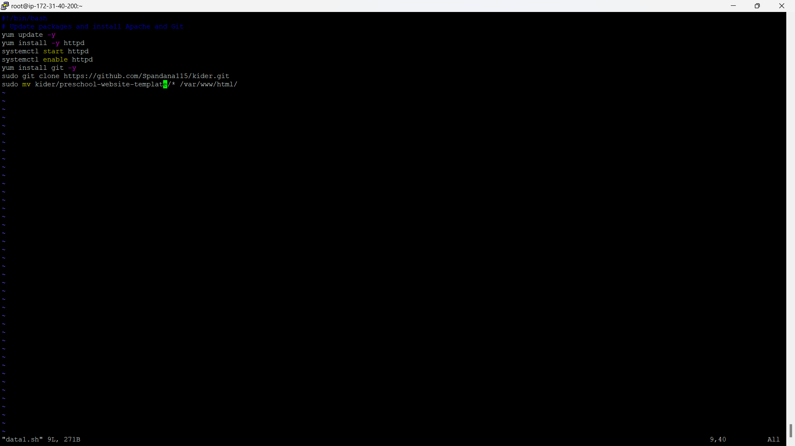
STEP- 6 USER DATA
User Data in AWS is a script or set of instructions that are automatically executed when an EC2 instance is launched. It is used to configure the instance, install software, or perform any setup tasks during the instance initialization. User data helps automate the process of configuring instances, so you don't need to manually set them up after launch. It is commonly used for tasks like installing packages, setting up configurations, or starting services on the EC2 instance.

Slide 29
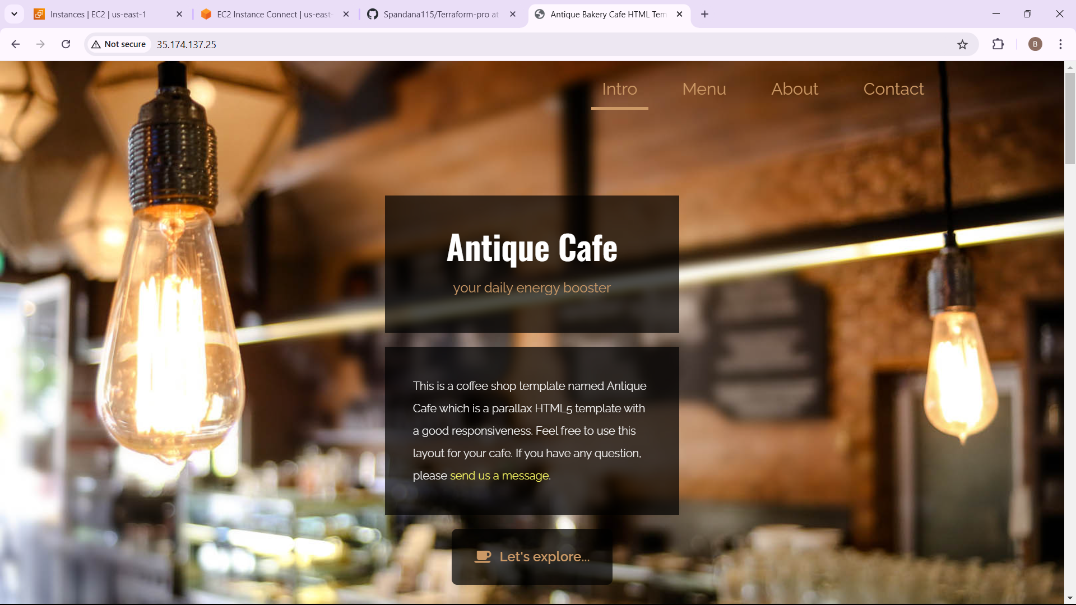
OUTPUT FOR USER DATA

Slide 30
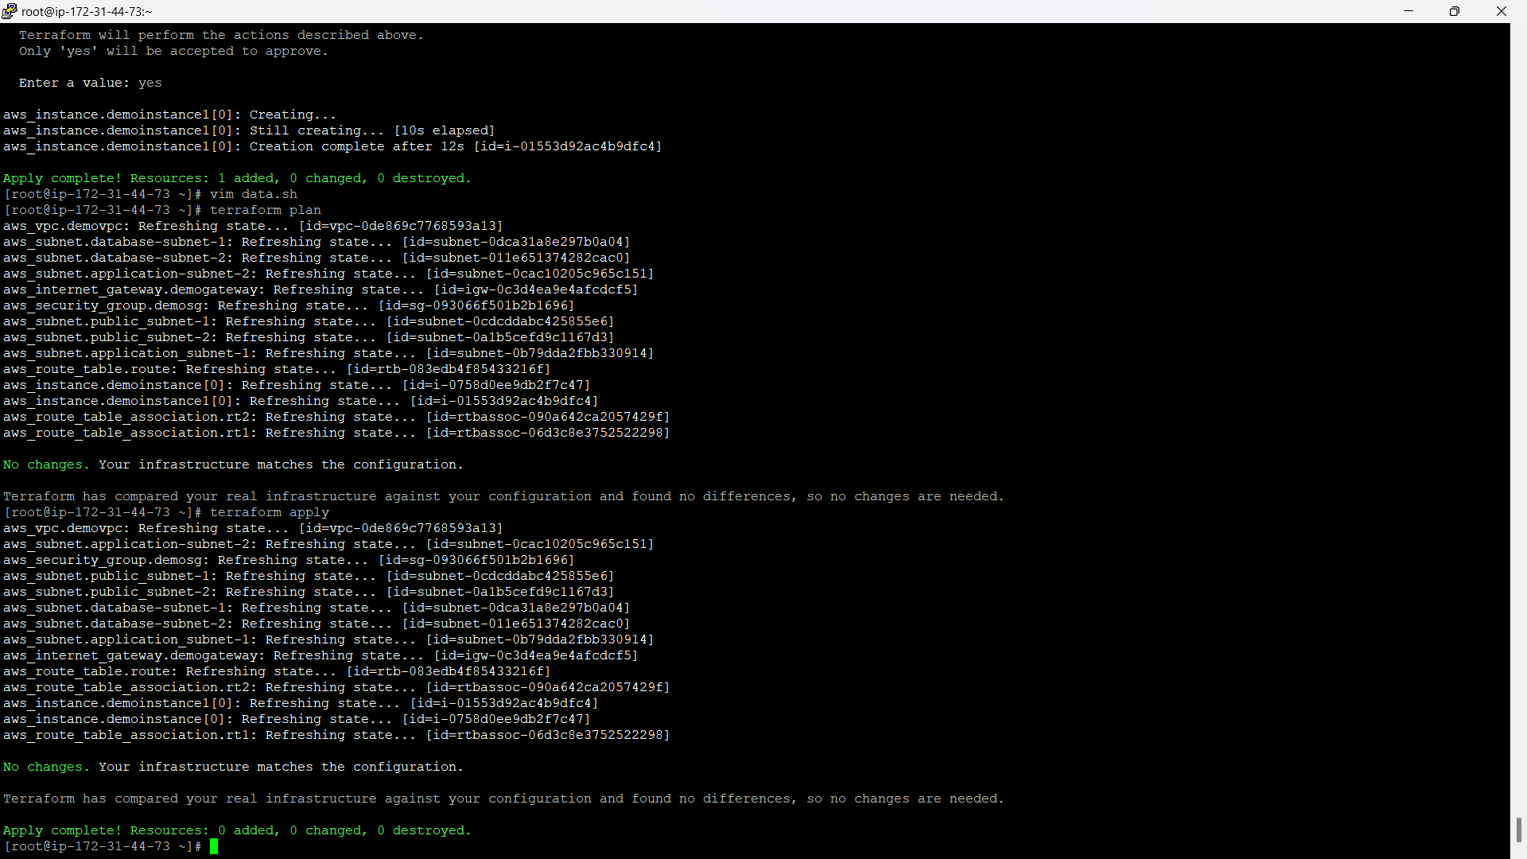
STEP- 8 CREATE EC2 INSTANCE
An EC2 instance (Elastic Compute Cloud) is a virtual machine in AWS that allows you to run applications and services in the cloud. It offers flexible computing power, enabling you to select the right instance type depending on your performance requirements, such as CPU, memory, and storage. You can easily manage EC2 instances through the AWS Management Console or APIs. These instances support various operating systems, including Linux and Windows, and can be scaled up or down based on your needs.

Slide 31
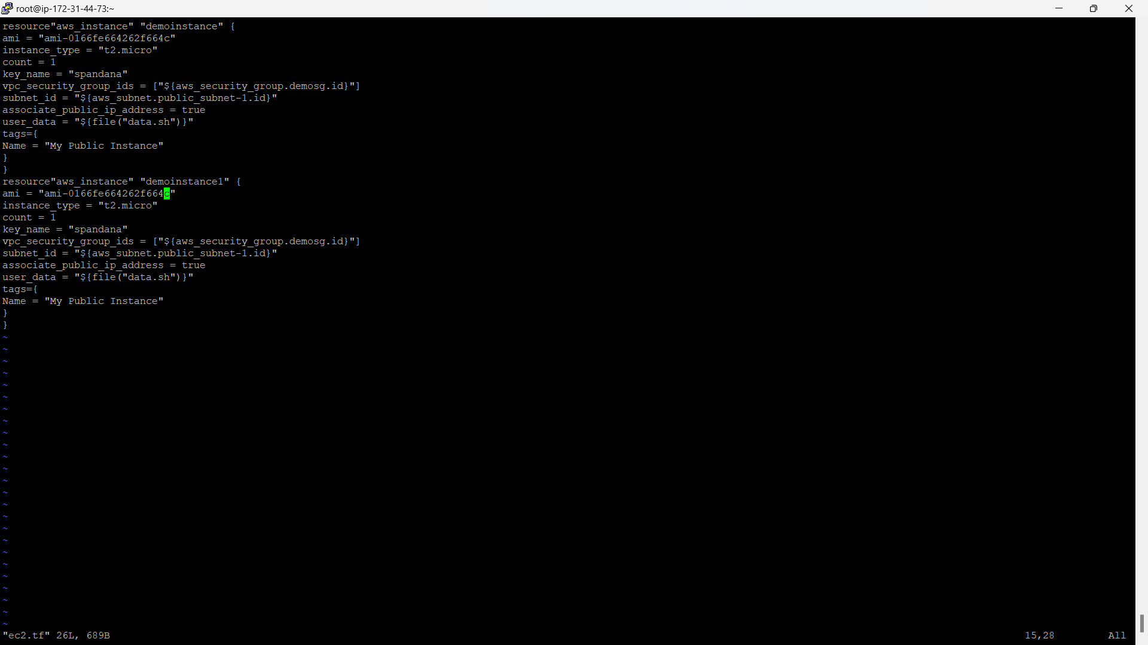
Ec2.tf file for creation of ec2

Slide 32
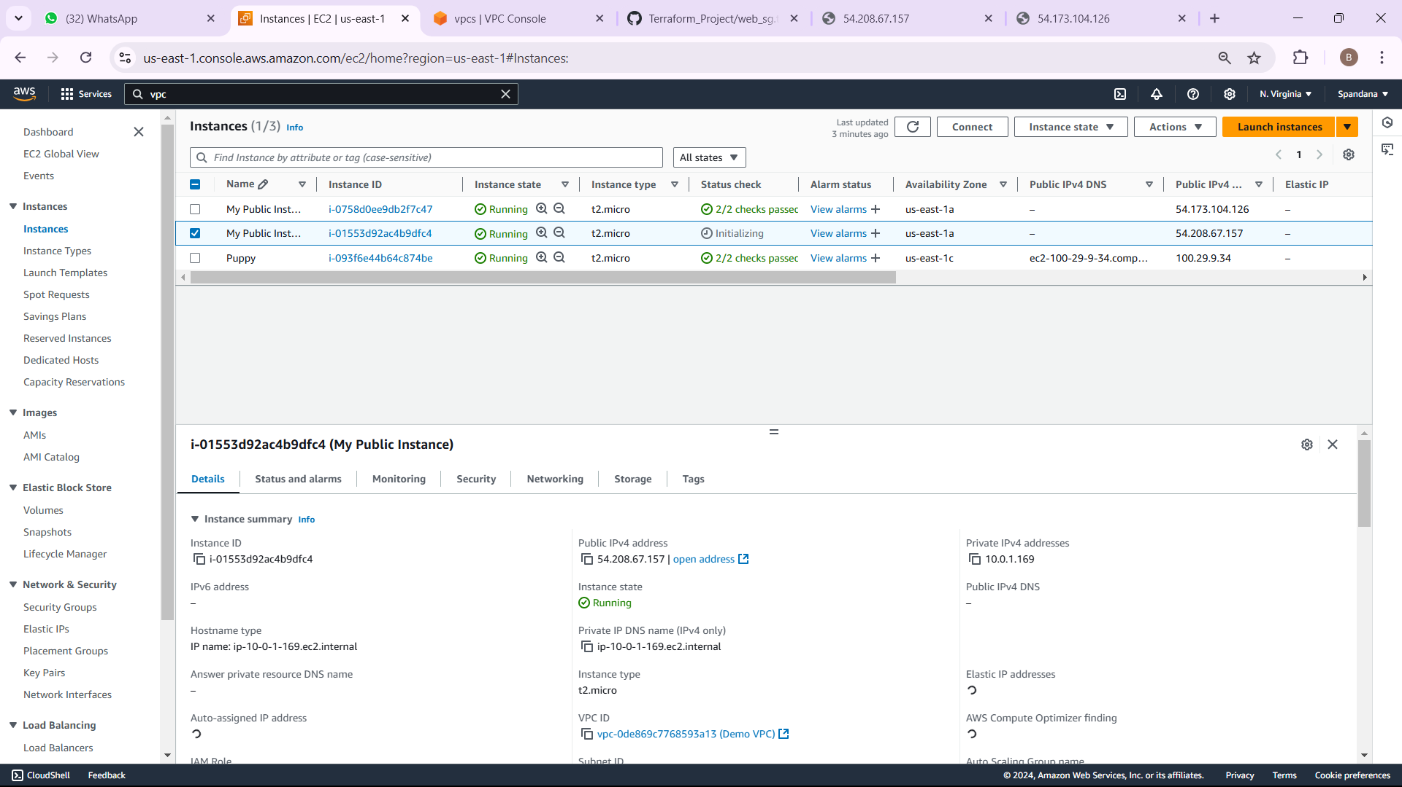
OUTPUT FOR THE EC2

Slide 33



OUTPUTS FOR VERIFICATION

Slide 34
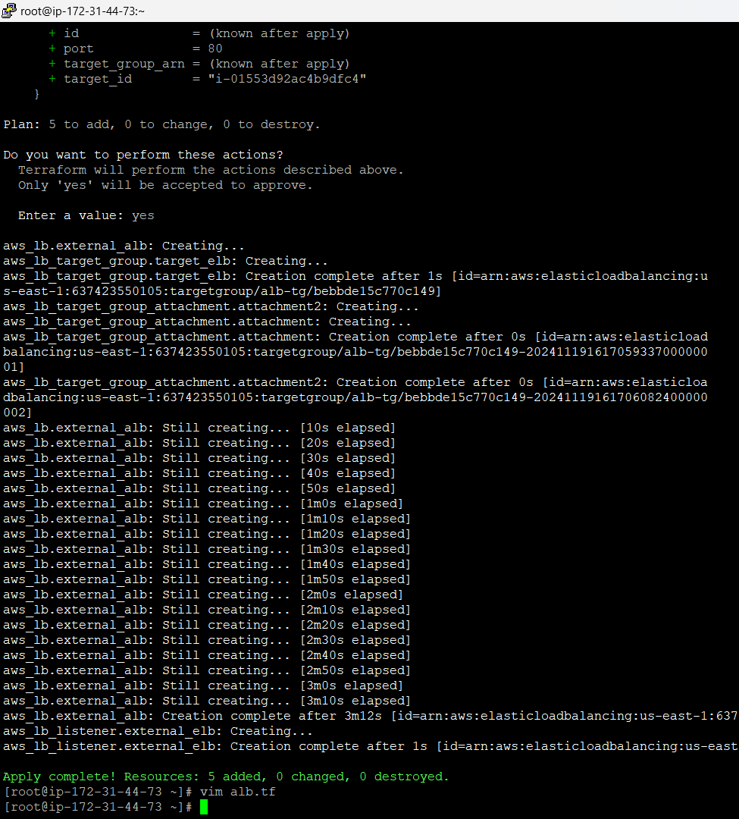
STEP- 10 CREATE AN LOAD BALACER
An Application Load Balancer (ALB) in AWS is a managed service that distributes incoming traffic across multiple targets, such as EC2 instances, to maintain high availability and reliability. Operating at the application layer (Layer 7), it can intelligently route traffic based on content, like URL paths or host headers, making it a great choice for web applications.

Slide 35
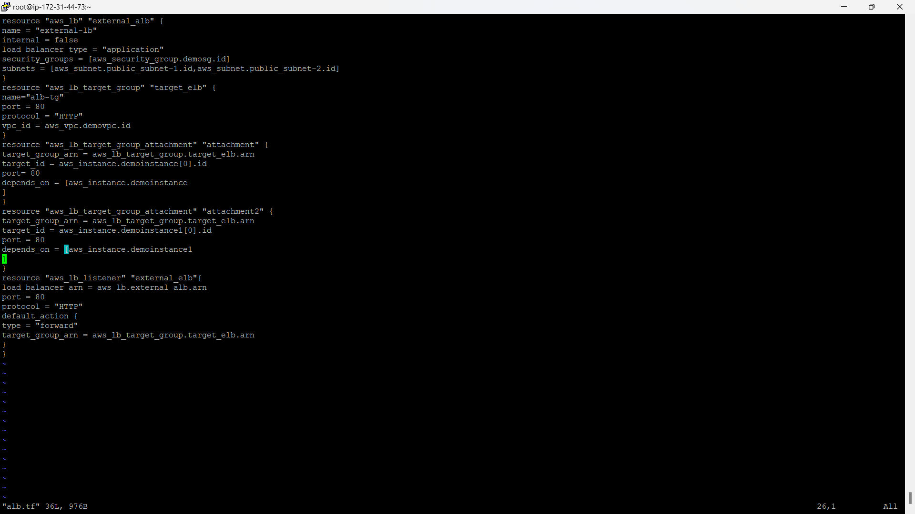
Alb.tf file for creating an load balancer

Slide 36
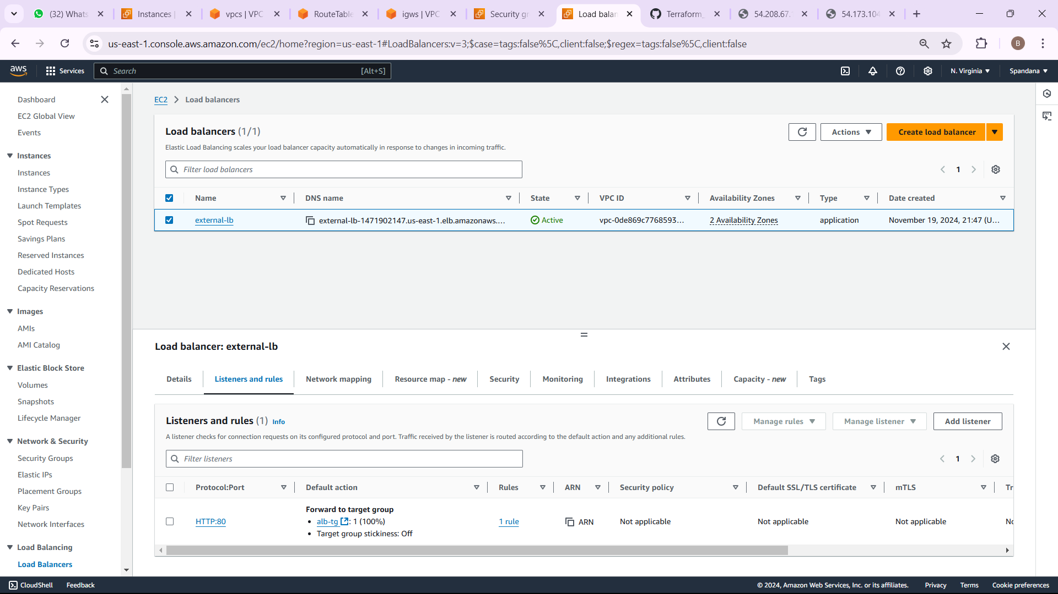
OUTPUT FOR LOAD BALANCER

Slide 37
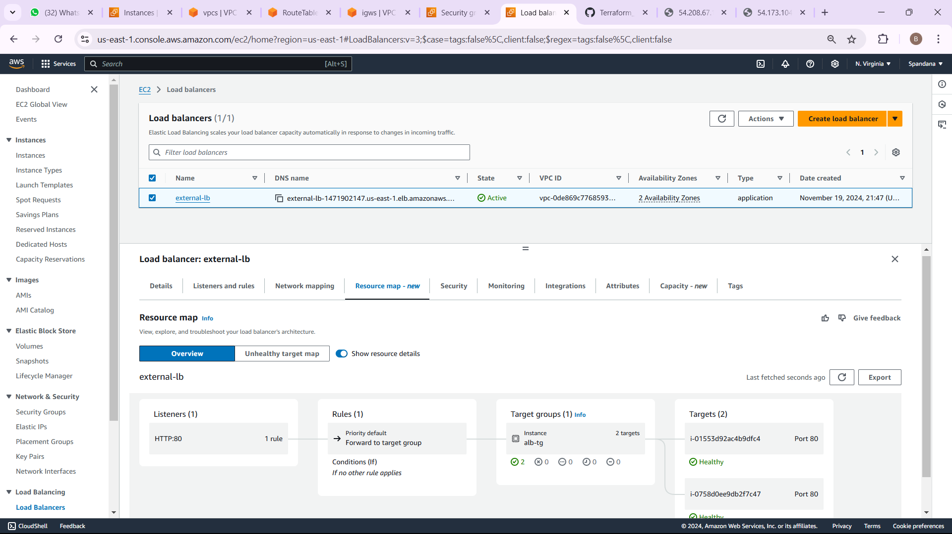
Resource map for Application Load Balancer

Slide 38
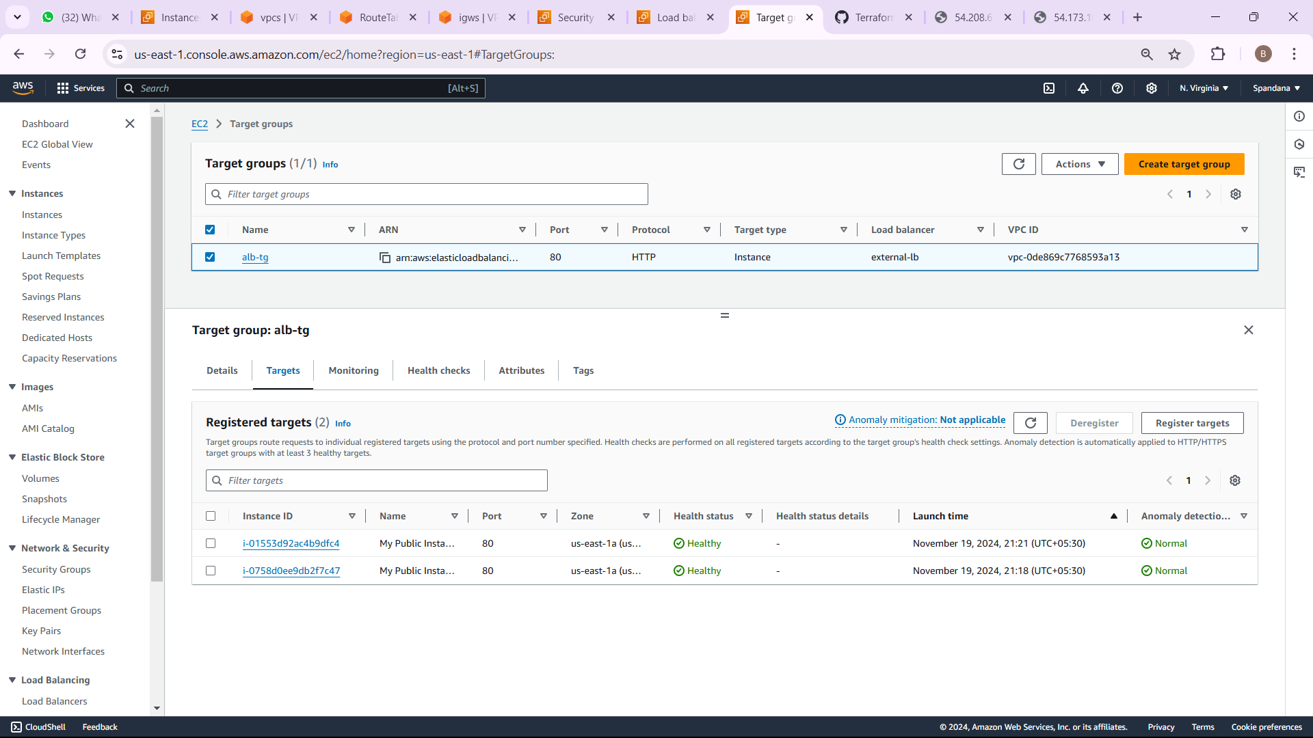
Target group

Slide 39

OUTPUT FOR LOAD BALANCER

Slide 40
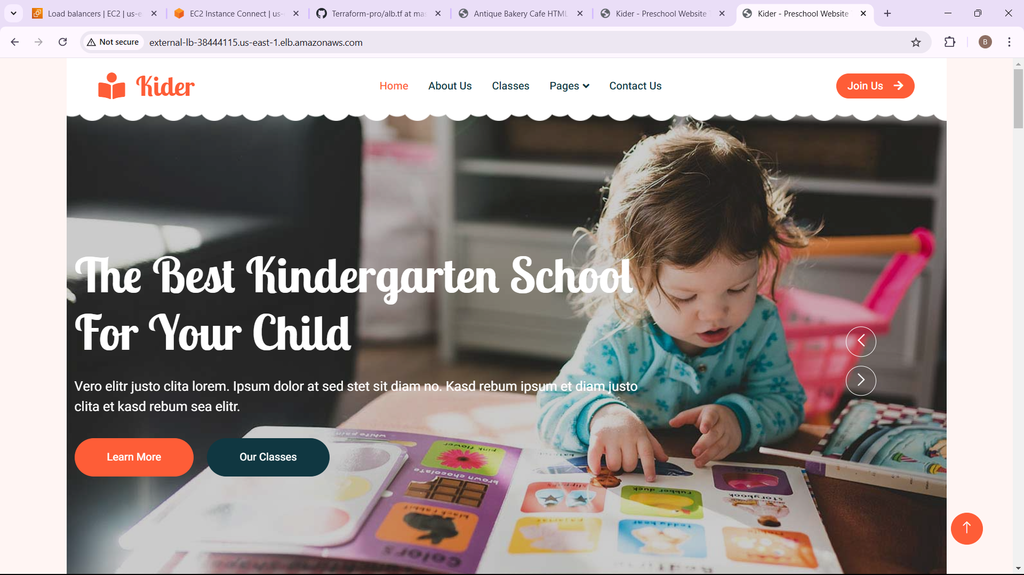
OUTPUT FOR LOAD BALANCER

Slide 41
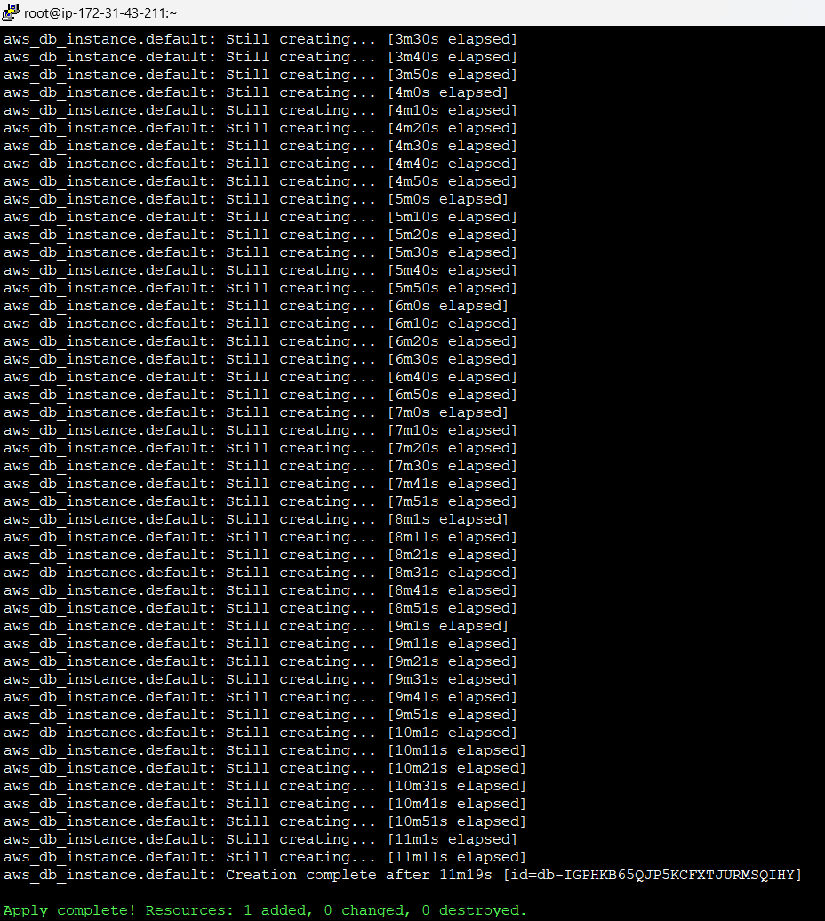
STEP- 10 CREATE AN RDS(Relational Databases)
An RDS (Relational Database Service) instance in AWS is a fully managed service designed to simplify the setup, operation, and scaling of relational databases. It supports various database engines, such as MySQL, PostgreSQL, Oracle, SQL Server, and MariaDB, providing flexibility and ease of use for different applications.

Slide 42
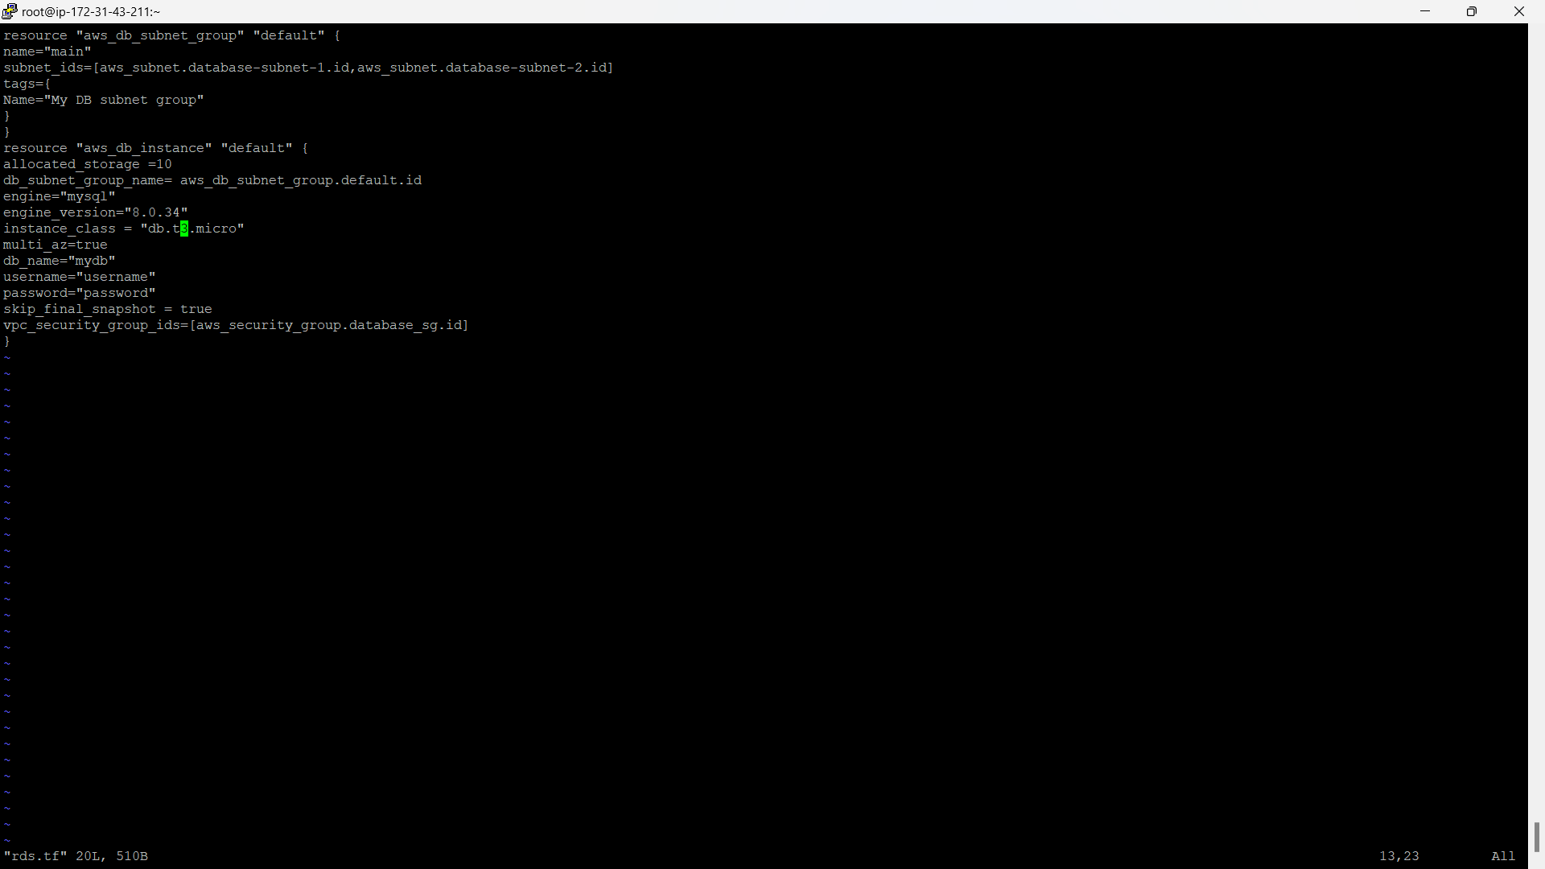
rds.tf file

Slide 43
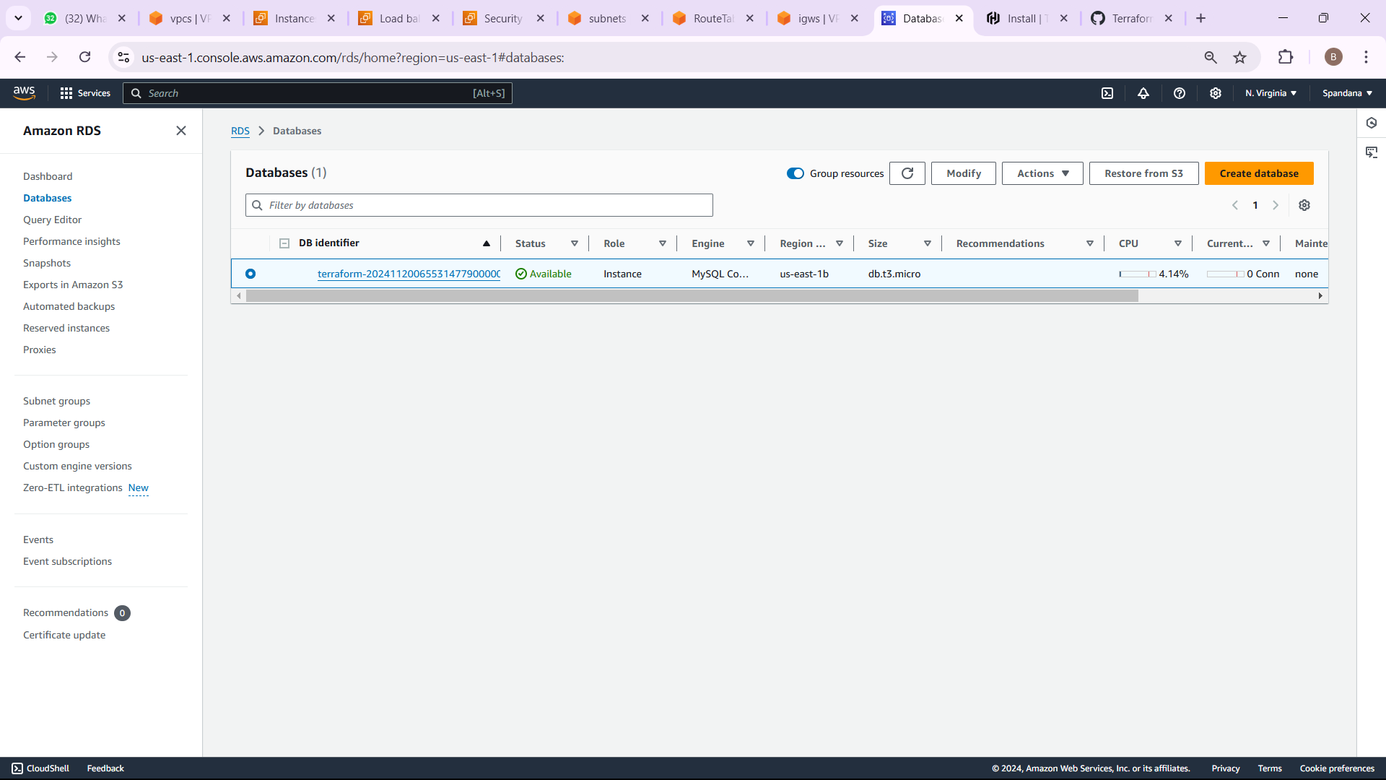
OUTPUT FOR RDS

Slide 44
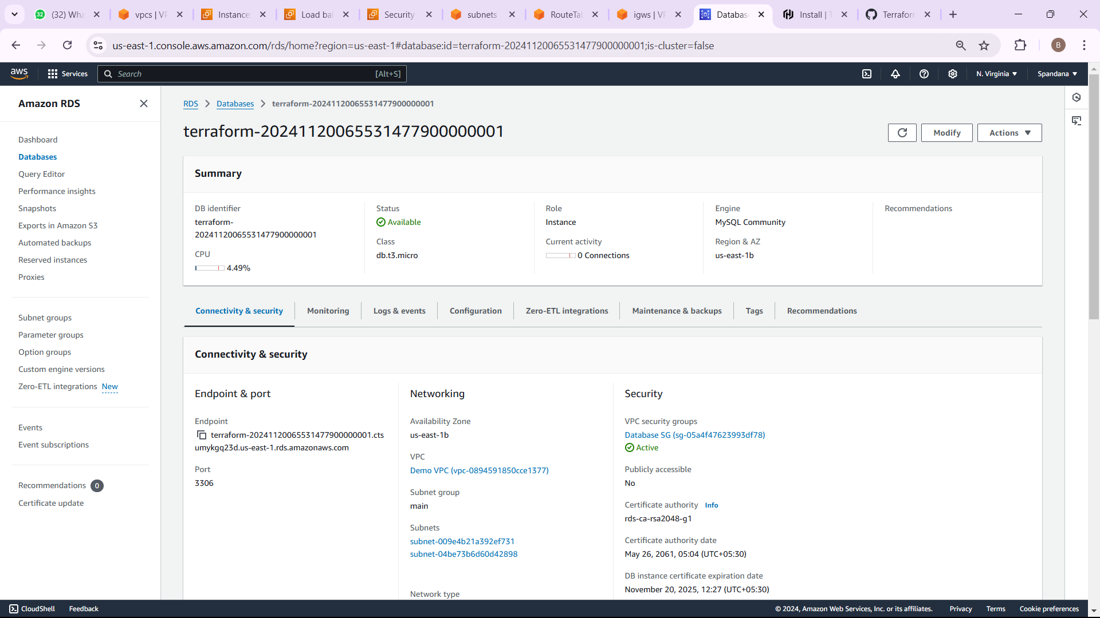

Slide 45
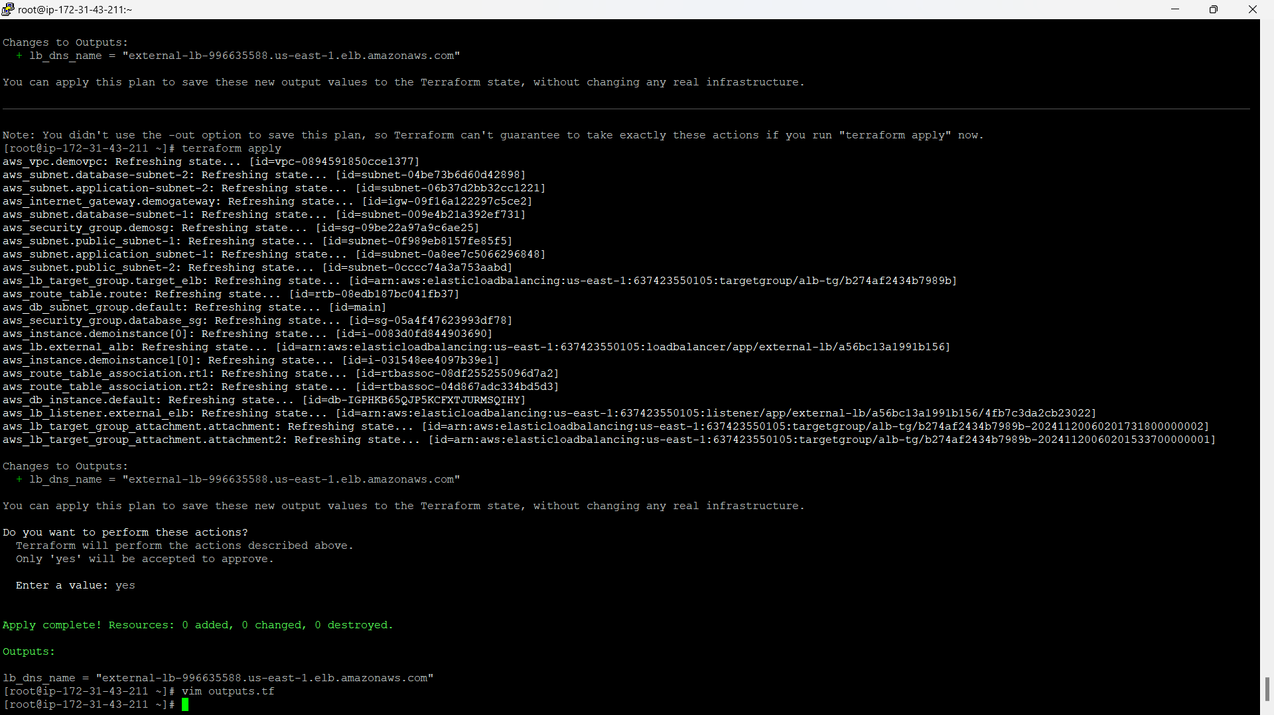
STEP- 12 OUTPUTS
The output block in Terraform is used to show the value of a resource or variable after the infrastructure is deployed or updated. For instance, it can display the DNS name of an AWS Application Load Balancer (ALB), making it easy to access or reference important details about the created resources.

Slide 46
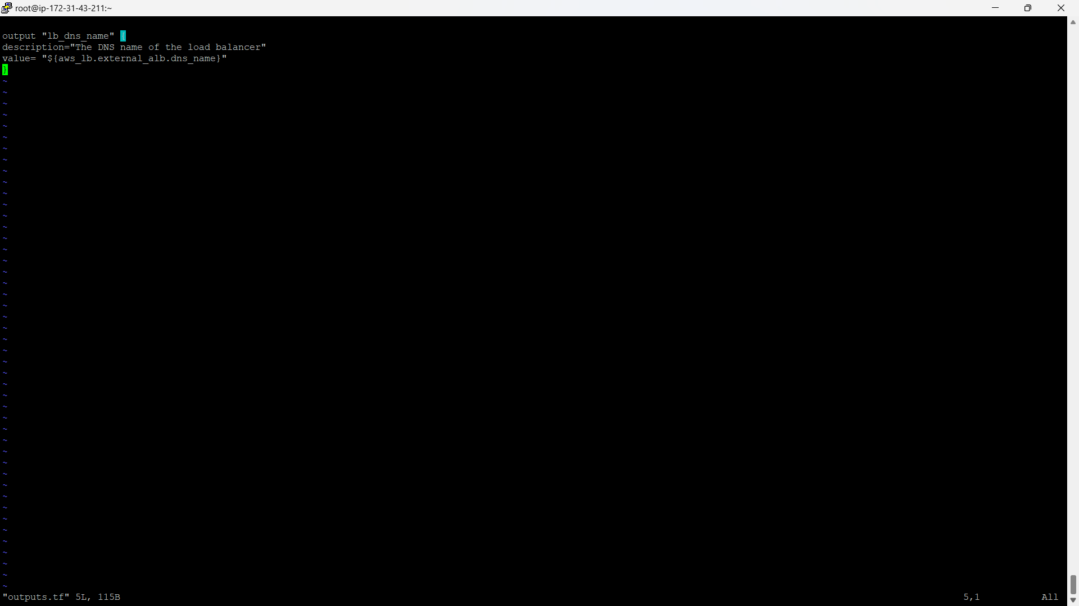
Output.tf file

Slide 47
THANK YOU ☺

